Slide 1
Promises and pitfalls of Autonomous vehicles
Implications for the insurance industry

Slide 2
Our team
Sara Ploch
Bethany Gschwind
Thomas Sussman
Ovidijus Riauba
Geovane Rivas
Faculty Advisor: Daniel Engler

Slide 3
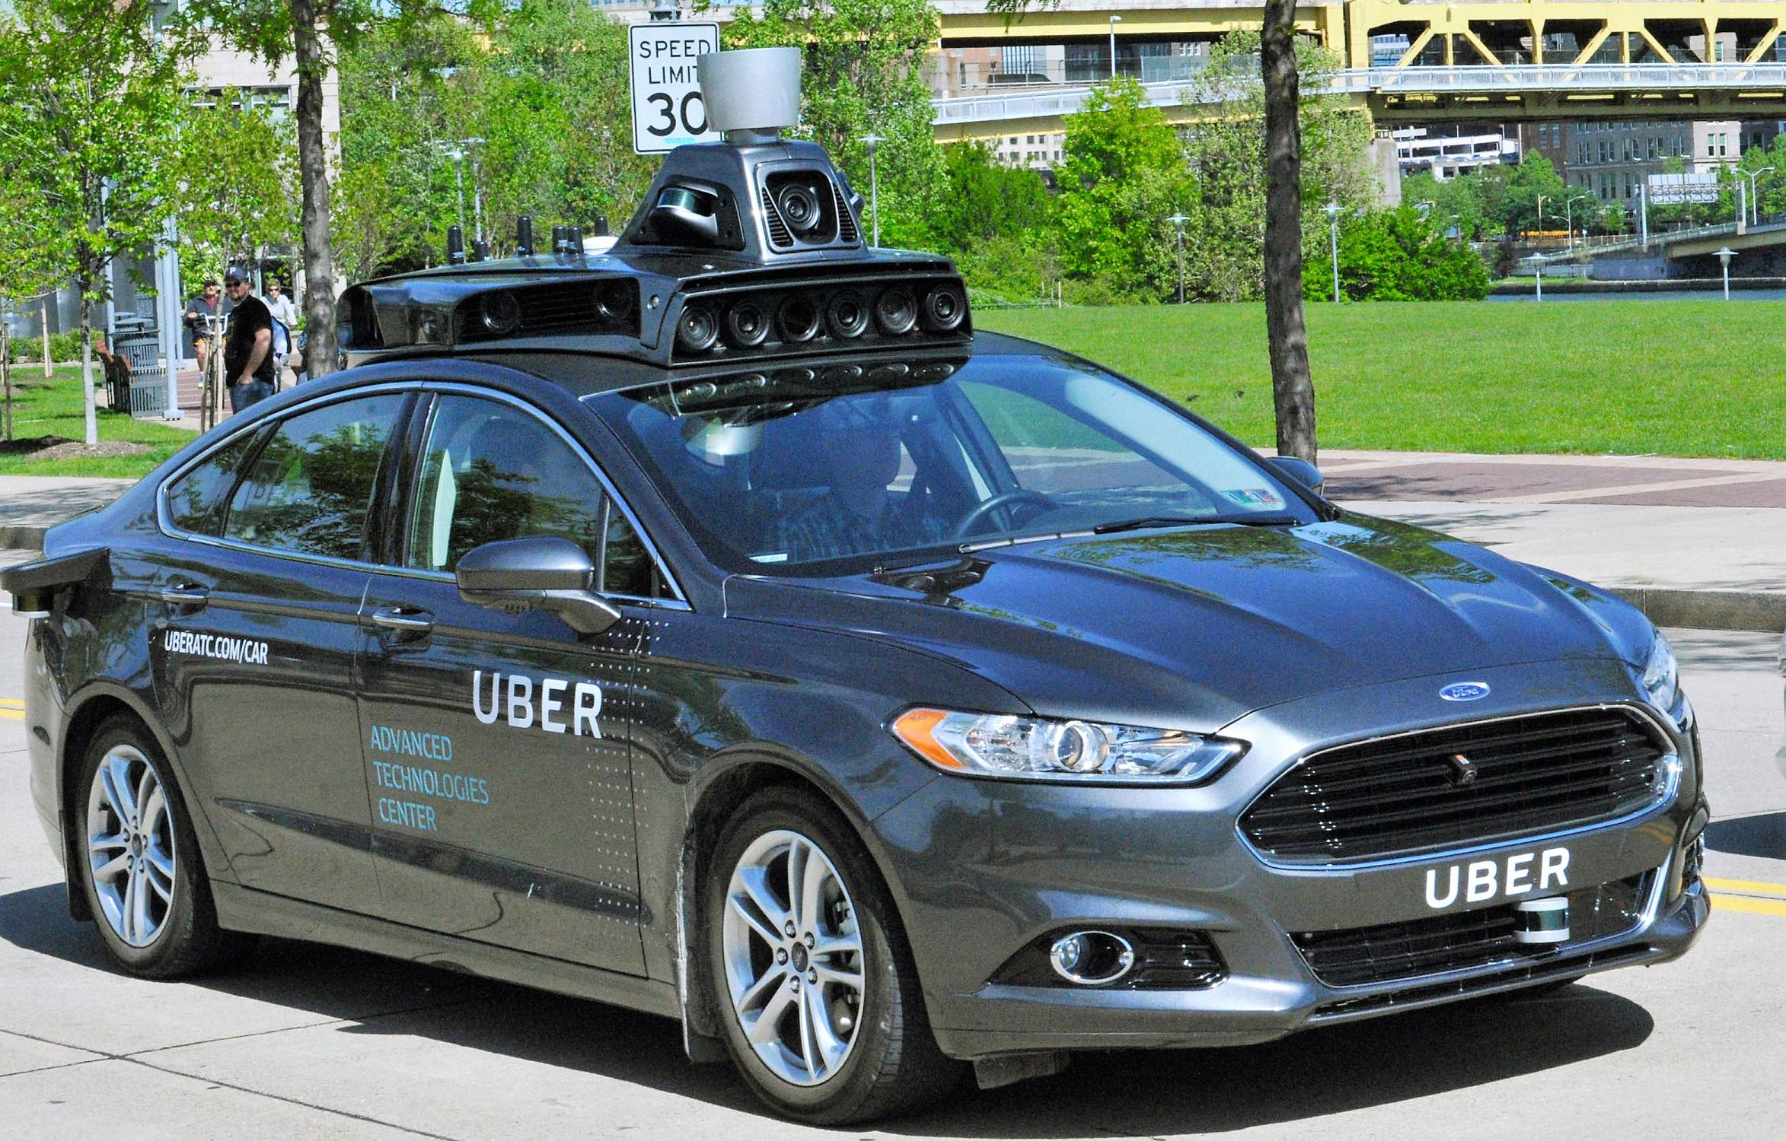
What are autonomous vehicles?
Merriam Webster Defines automation as the automatic working of a machine, process, or system by mechanical or electronic devices that take the place of humans

Slide 4
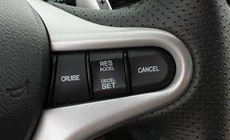
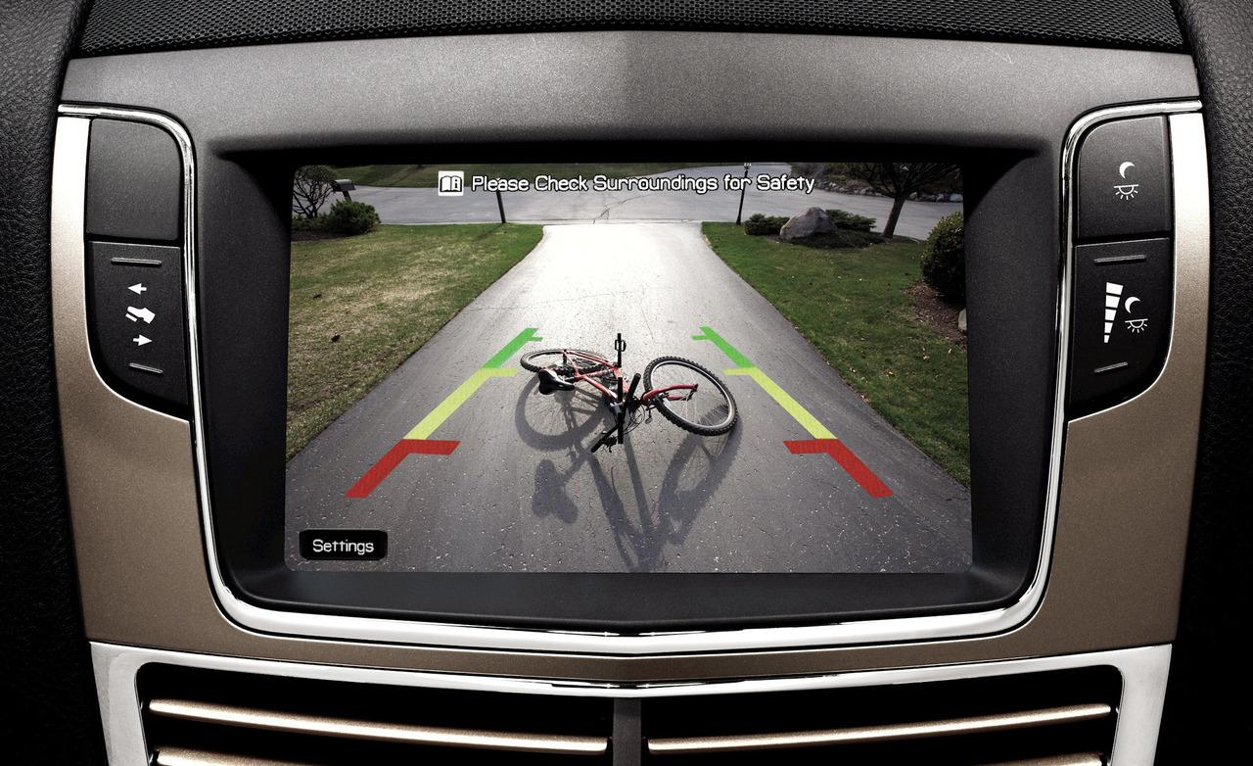
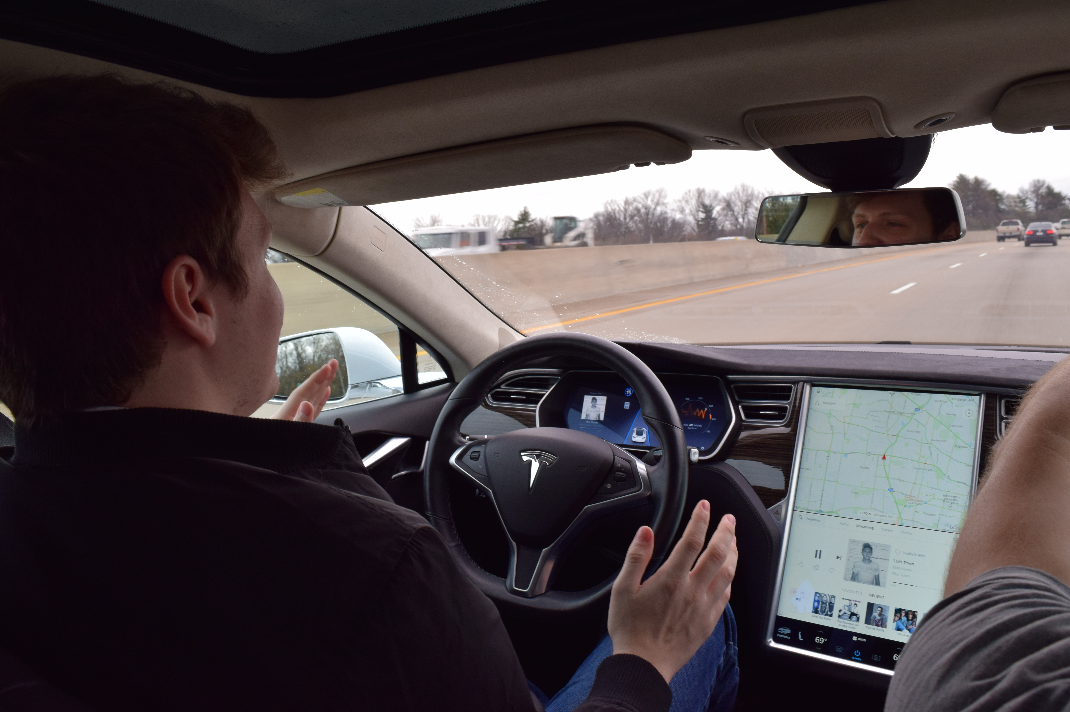
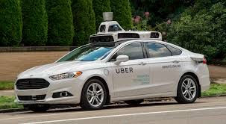
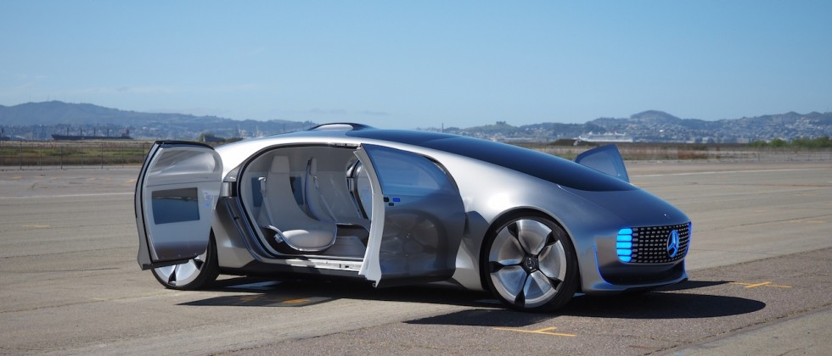
autonomous technology in vehicles

Slide 6
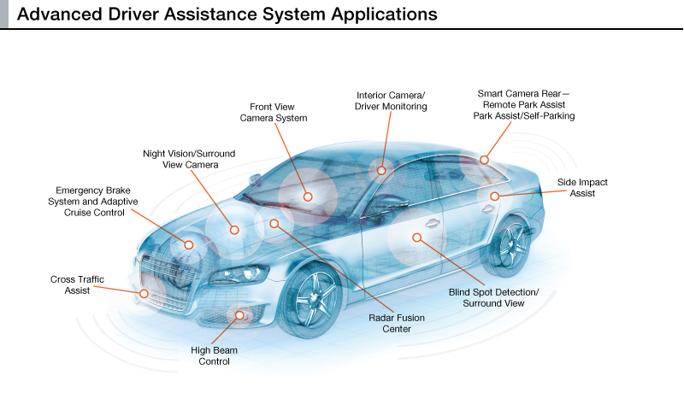
Where are we now?
ADAS – systems designed to help the driver in basic driving functions.
Examples of ADAS:
Forward Collision Avoidance
AutoPilot
Adaptive Cruise Control
Lane Changing Assistance
Self-Parking
And many more

Slide 7
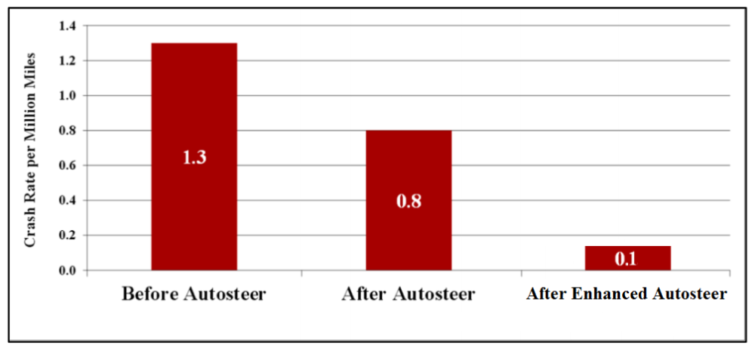
Tesla’s AutoPilot proven safety

Slide 8
Technology
Future Capabilities
Waiting on Regulation
Fully autonomous
Companies announce autonomous vehicles
Notes:
Fully autonomous: vehicles will communicate with each other and there will be no need for an attentive driver.
Companies announce autonomous vehicles:
Delphi-2019
Audi-2020
Ford-2021
Volkswagen-2019
GM-2020
BMW-2021

Slide 10
Implications for the insurance industry in the short-term
A study conducted by McKinsey reports that 20 percent of vehicles globally are expected to come with safety systems within ADAS by 2020, reducing the number of accidents and thus the value of personal auto policies.

Slide 11
Adas will lead to road safety

Slide 13
How long do insurer’s have?
1972: The Federal Government requires three-point seatbelts to be installed at manufacturing of every car.
1959: The Three-point seatbelt is designed and patented, proving more safe and effective than previous designs
1984: New York becomes the first state to require the wearing of seatbelts while driving.
1930’s:
Seatbelts are first put into cars during manufacturing
How will ADAS’s like Forward Collision Avoidance factor in over time? When will these driver safety features be required in all vehicles?

Slide 14
Opportunities for insurers rising from tech changes
Connected ADAS will give insurers resources to enhance profits and cut underwriting costs.
Usage-Based Insurance

Slide 15
Threat of New Entrants
Competition vs. teamwork between sectors
Possible Competitors:
Software development Companies
Automakers
Auto Parts Manufacturers
Car Dealerships
kpmg.com/insurance
Notes:
Competition vs. Teamwork: Different sectors are competing/fighting each other rather than everyone working together to make autonomous vehicles a success
Insurers delaying the creation of business models for these new technological advancements could leave room for competition entering from adjacent industries, like software development companies and automakers or auto parts manufacturers.
Explain the chart

Slide 16
How self driving cars will affect the insurance industry in the long term?
Personal Auto Risk for driver Product Liability Risk for manufacturer
By 2035, the McKinsey report suggests personal auto premiums will fall 25%, and personal auto underwriting profits could decline up to 40% because of semi/fully autonomous vehicles.

Slide 17
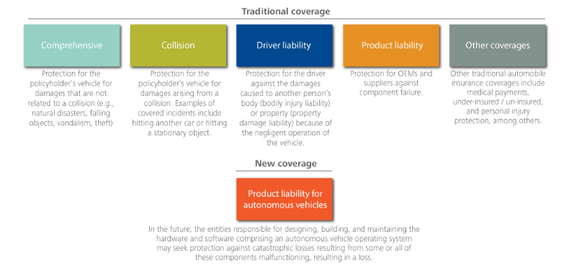

Slide 18
Legal Issues
Transition of Fault
Legal Impact
Setting Precedence
https://drive.google.com/open?id=0B7m_AKfavPPBcDdDajY1bHNZM0E
Notes:
Transition of Fault from driver to manufacturer or technology engineer
Legal impact: explain data

Slide 19
Commercial Implications
Stages might coexist for 10-15 years
Private ownership remains the norm
Ridesharing focused on point-to-point transportation
Private ownership of AV’s fueled by V2X capabilities
Convergence of autonomous and vehicle-sharing trends

Slide 20
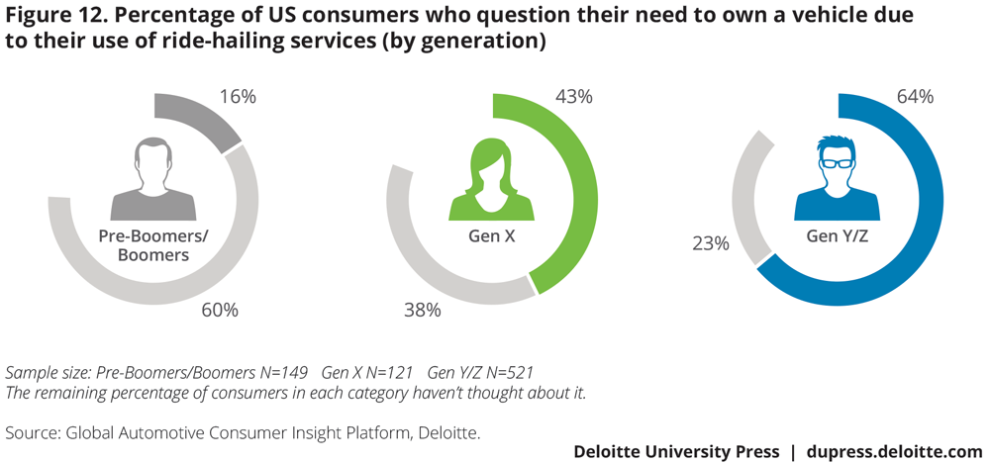
Consumer Adoption
Generation Gaps
Interest in full-self drive
Willingness to Pay
Vehicle Ownership

Slide 21
Consumer Adoption
Geographical Differences
Ridesharing key difference
Changing Trends
MaaS

Slide 22
Consumer Adoption - Safety
Full autonomy is not trusted
Opportunity for ROI
Proportional concern for safety across demographics

Slide 23
Commercial Promises
Otto and Embark are currently testing trucks on the road
There are a mix of driver assist (level 3) and fully autonomous (level 4 or 5) promises for 2021
A lot of companies are focused on creating vehicle-on demand fleets for fully autonomous vehicles
There are also promises for public transportation that are fully automated.

Slide 24
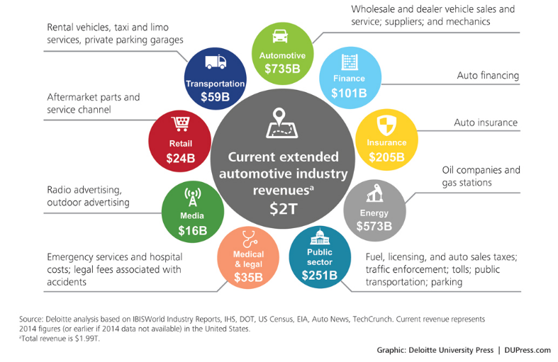
Cause and Effect
Notes:
Just a few of the different industries that the implementation of autonomous vehicles will affect

Slide 25
Summary
Autonomous Vehicles are happening right now.
Advanced Driver Assistance Systems are making vehicles safer than they have ever been.
Insurers need to react to the changing technology in automobiles to avoid being left behind in the digital world.
Commercial adoption of these vehicles will change our society in major ways.

