Slide 1
Marketing Plan Outline
Illinois State University Market
April 7, 2017
Val Ilyukhina, Tim Abad, Tyler Robinson
Dr. Peter Kaufman, Project Mentor
Missy Nergard, Mentor
Notes:
Everyone: Thank you’s and introduce ourselves – Val goes last to transition to next slide

Slide 2
A
G
E
N
D
A
2. Situation Analysis
1. Project Overview
Normal, IL
Customer Analysis
4. Marketing Mix
5. Recommendations
Notes:
VAL

Slide 3
A
G
E
N
D
A
Project Overview
Company Overview
Goals & Objectives
Situation Analysis
Local Industry Analysis
Environmental Analysis
Company Analysis
Competitor Analysis (Levels of Competition)
Opportunity and Issue Analysis (SWOT)
Customer Analysis
Demographics
Research & Analysis Methods
Interviews
Survey Data Statistics
Survey Data Takeaways
Market Segmentation
Marketing Mix (Price, Place, Promotion)
Recommendations
Short and Long-Term Projections
Q & A
Notes:
VAL

Slide 4
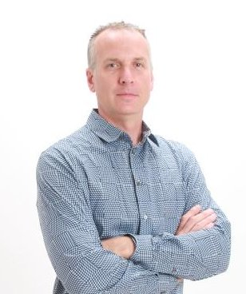
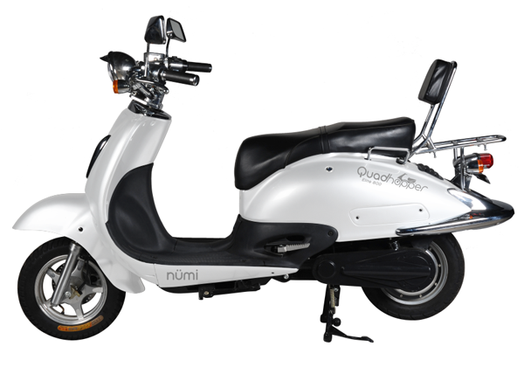
Project Overview - Company Overview
Ron Glogovsky
ISU Alum and self described serial entrepreneur
Founder and President, College Scooters Inc.
Based out of Sycamore Illinois
Trademarks include Numi and Quadhopper
President, West London Graphics Inc.
2002 media solution startup that was self funded and grew to over 10 million dollars in revenue in a few years
President, Electric Limo Company Inc
Chicago startup now operating in Hawaii that exclusively uses Tesla Model S and Model Xs to transport clients to/from airports, concerts, weddings, and night outs.
Quadhopper E-Bike
Quadhopper Elite Scooter
Notes:
TYLER

Slide 5
Company Overview (cont.)
Goal: hold position as only company to provide electric bicycles and scooters to high school and college students at a reasonable price, with unique and fun features
Supporter of Rainforest Foundation
2% of each purchase
Notes:
TIM

Slide 6
Goals & Objectives
Preliminary Market Analysis
Explorative Market Survey
In-person Interviews
Notes:
TIM

Slide 7
2. Situation Analysis – Local Industry Analysis
High
Moderate
Low
Threat of New Entrants
Threat of
Substitutes
Bargaining Power
of Suppliers
Bargaining Power
of Buyers
Competitive
Rivalry
Notes:
TIM

Slide 8
Environmental Analysis
Will they contribute to Numi’s success or failure?
Success
Failure
Political & Legal Environment
Economic Environment
Social & Cultural Environment
Technological Environment
Notes:
TYLER : 1 sentence for each

Slide 9
2. Company Analysis
“Help you get where you’re going in a fun, stylish, eco-friendly way. Numi is dedicated to next-generation transportation – leasing and renting electric scooters and ebikes to high school seniors and college students.”
Strengths | Weaknesses
New to market opportunities Delivery for on-campus pick-up Environmentally friendly Quiet Availability of bicycle parking Customization Low cost manufacturing (overhead) | Technology (no app) Price Security Maintenance Brand awareness Seasonal Limited styles
Notes:
TIM

Slide 10
2. Levels of Competition
Entertainment
Bicycles
Zagster
Brand Competition
Vitesse Bike Shop
Bed, Bath, Beyond
Product Competition
Cars
Walking
Generic Competition
Total Budget Competition
ReggieRide
Public Transportation
Tuition
Notes:
TYLER

Slide 11
2. Competitor Analysis - Primary Competitors
 | Price | Speed* | Range | Strengths | Weaknesses
Numi | $1,374.99 | 16 mph | 44 miles | Easy delivery to campus Partnership with Rainforest Foundation | Lack of on-site maintenance
Vitesse | $2,799.99 | Varies | Varies | Owner Proximity to campus Trained staff Name-brand components | Few models in stock Price: $1,700 to $3,000
Bed Bath and Beyond | $899.99 | 20 mph | 22 miles | Major retailer Technology Foldable model | Proximity to campus Maintenance Limited warranty
*as advertised
Notes:
TYLER

Slide 12
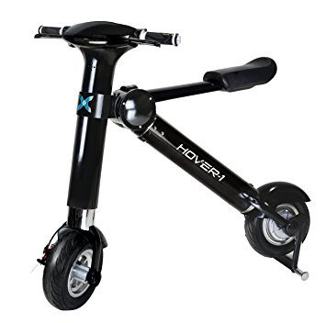
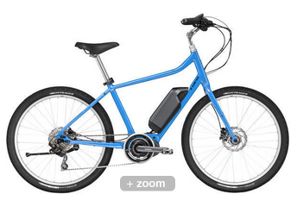
Notes:
TYLER

Slide 13
2. Competitor Analysis - Threatening Alternatives
 | Price | Access | Strengths | Weaknesses
Numi | $1,374.99 | Delivery | Competitive Pricing Distribution Center Close | Not located on campus No onsite maintenance
ReggieRide | Free for students | Check out at Rec Center | Free Located on campus Equipped with bike lock and solar powered light | One location to check out/return Limited number of bikes Not available all year
Zagster | $3/hr max $30/day Overnight fee | 9 locations in Normal | Technology based Located on campus and across town Brand awareness | Cost of Operation Manitenance Royalties Profit margin
Notes:
TYLER

Slide 14
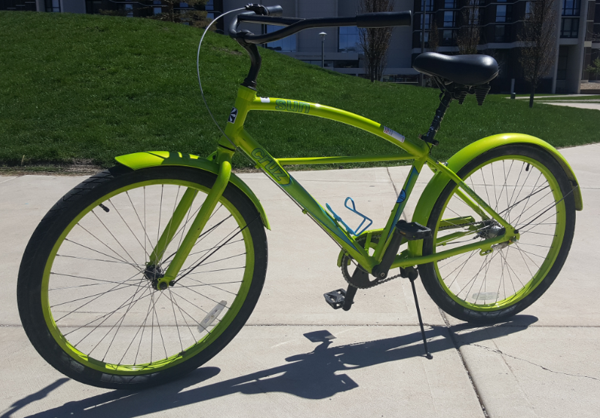
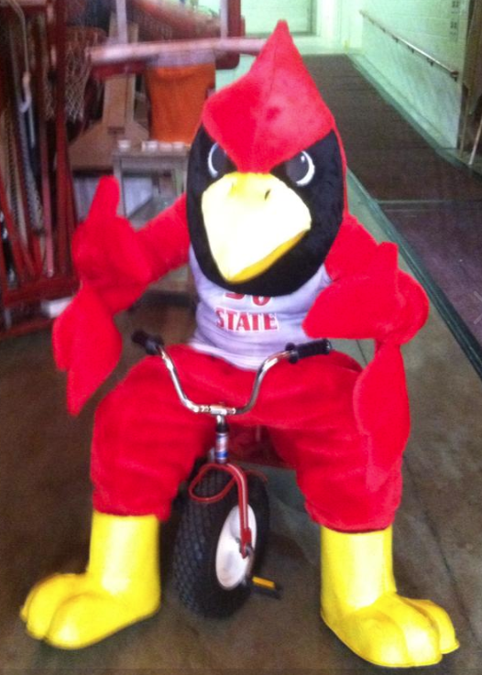
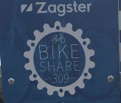
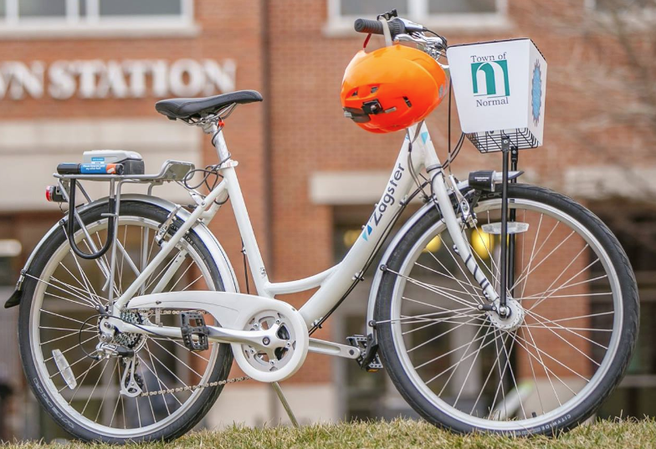
Notes:
TYLER

Slide 15
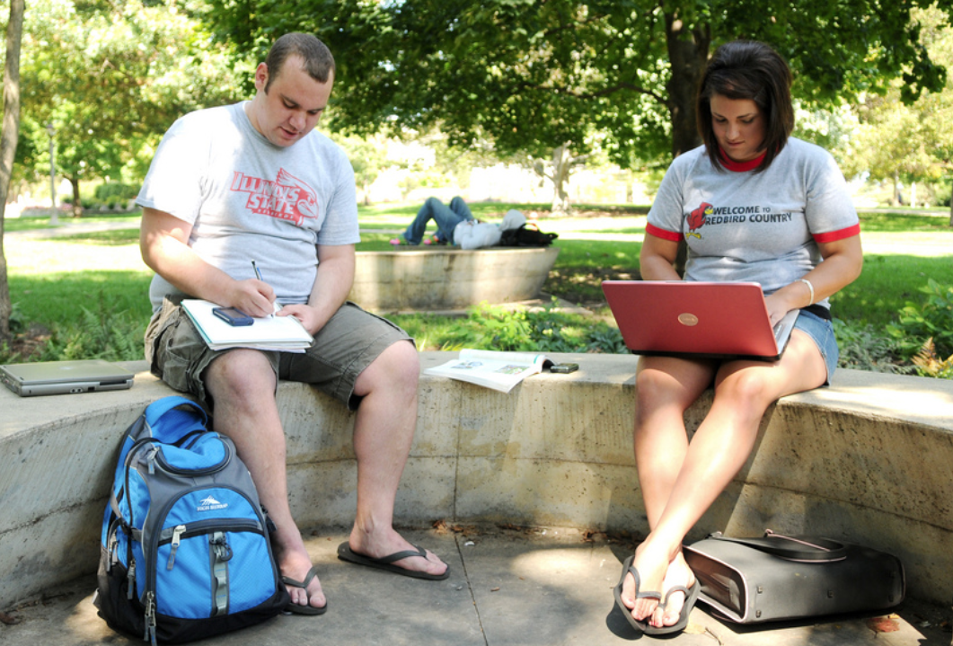
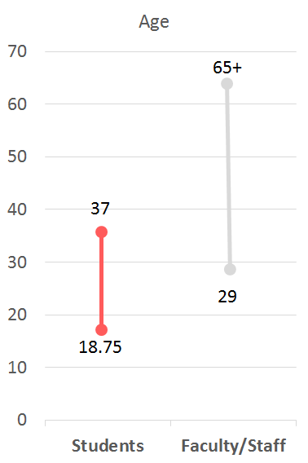
3. Customer Analysis - Demographics
Population Types:
Urban Commuters
Outdoorsy
Recreational
“Green” Users
Tech Enthusiasts
Notes:
VAL

Slide 16
3. Research & Analysis Methods
Exploratory Survey
Administered to students, faculty, staff
11 questions, asked by ICC team
20 respondents
Secondary research
Numi pilots on west coast
Online research of other e-bike companies’ business models (including Zagster)
In-person Interviews
Notes:
VA

Slide 17
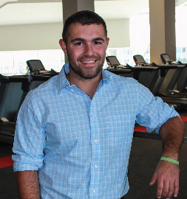
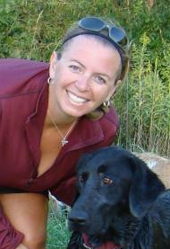
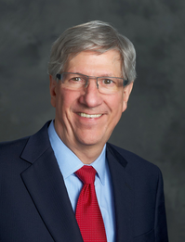
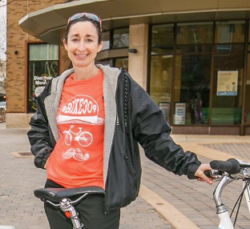
3. Interviews
David Kirk, ReggieRide Program Coordinator
Mercy Davison,
Normal Town Planner
Chris Koos, Normal Town Mayor & Owner of Vitesse Bicycle Shop
Missy Nergard, ISU Office of Sustainability
Photos sources: Kirk and Nergard - ilstu.edu, Davison - #rideshare309 on Facebook, Koos - Town of Normal website
Notes:
VAL

Slide 18
3. Survey Data Statistics
20 Respondents – 11 students, 8 staff, 1 faculty
Where do you currently live?
On-campus: 6
Off-campus < 3 miles: 5
Off-campus > 3 miles: 9
How do you typically travel to campus?
Drive alone: 11
Notes:
VAL

Slide 19
3. Survey Data Statistics (cont.)
3. When considering an electric bicycle, rate the following factors:
Important (1) |  | Somewhat Important (2) |  | Neutral (3) |  | Somewhat Unimportant (4) |  | Unimportant (5)
Quality | Mean | Quality | Mean | Quality | Mean | Quality | Mean | Quality | Mean
Charging | 1.05 | Style | 2.11
Good value | 1.21 | Range | 2.32
Comfort | 1.42 | Environment | 2.47
Maintenance | 1.68 | Speed | 2.63
 |  | Technology | 2.79
Notes:
VAL

Slide 20
3. Survey Data Takeaways
Generally, how do you feel about transportation to campus?
There is not enough parking
Issues with bus [new route]
Parking is too expensive
Good bike accessibility
Are you aware of the ReggieRide program available through the ISU Rec Center?
75% said NO
Notes:
VAL

Slide 21
3. Survey Data Takeaways
If you were to buy an electric bicycle/scooter, how much would you be willing to pay?
Almost 100% of respondents said under $1,000
Would you be interested in a rent-to-buy option?
75% said YES
Notes:
VAL

Slide 22
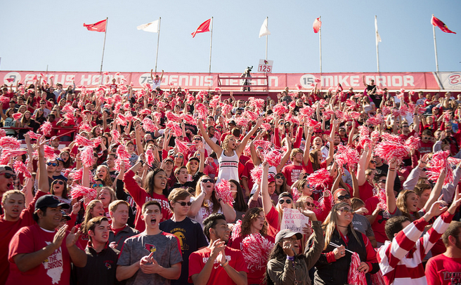
4. Market Segmentation
Primary Target Market
Segment 1: Undergraduate/Graduate ISU Students
Daily users
Dorms to Diplomas
Lack of personal vehicle or close parking
What they want
Convenience, low price, ease of use, ease of maintenance
Support Requirements
24/7 support, battery charging, maintenance, storage
Notes:
TIM: Daily users of product - define dorms to diplomas

Slide 23
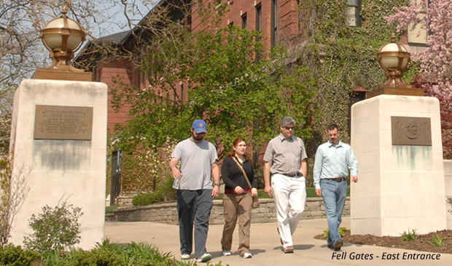
4. Market Segmentation (cont.)
Primary Target Market
Segment 2: Faculty/Staff
Daily users
Own personal automobile
Disposable income
What they want
Ease of use, sustainability, entertainment
Support Requirements
More tolerant of maintenance, good customer service
Notes:
TIM

Slide 24
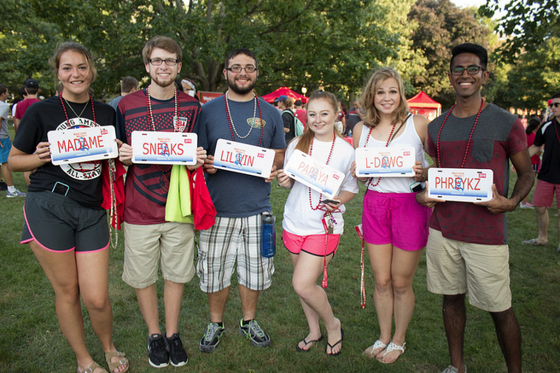
4. Marketing Mix - Primary Target Market: Segment 1
Undergraduate/Graduate ISU Students
Price
Rental model - lower price
Rent to buy discount options
Bundling
Place (Distribution)
Partnerships with area bicycle shops for placement and maintenance
Close proximity to campus
Notes:
TIM

Slide 25
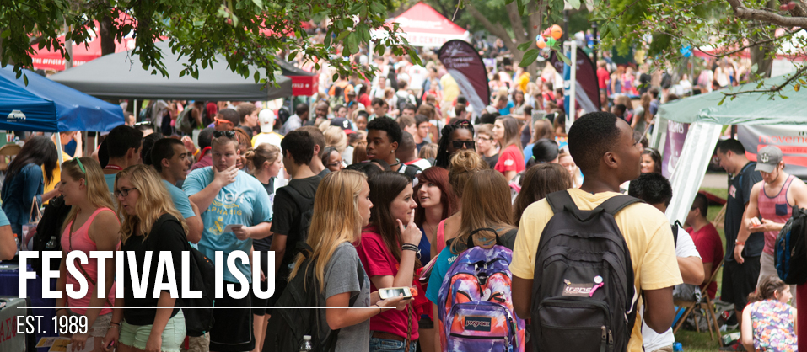
Marketing Mix - Primary Target Market: Segment 1
Promotion
Partner with ReggieRide
Summer Preview events
Advertise on campus and at campus events
Marketing through on campus apartment complexes
Advertise through public transportation
Student radio commercials
Notes:
TIM

Slide 26
5. Recommendations: Short and Long-Term Projections
Short-term Projections (3 – 5 years) - Pilot
ReggieRide Partnership (55%)
2,100 rentals in 2014 -> 4,250 rentals in 2016
Summer Preview events (15%)
Appeal to “decider”
Advertise on campus and at campus events (25%)
Transfer Day program
Student radio commercials (5%)
Long-term Projections (5+ years) - Implementation
Short-term brand awareness strategies (70%)
Marketing through on campus apartment complexes (15%)
Advertise through public transportation (15%)
Move to rental strategy
Partnerships with local retailers (sell)
Notes:
VAL

Slide 27
Questions?
Thank you!

