Slide 1
Uptown Normal Waste Diversion
Innovation Consulting Community
Jenny Chun, Michael Feezer, Jessica Hoberg,
Agnes Kowalski, Yao Yao

Slide 2
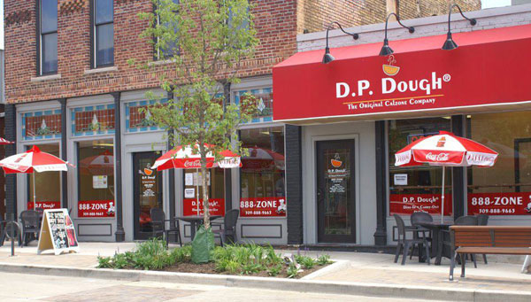
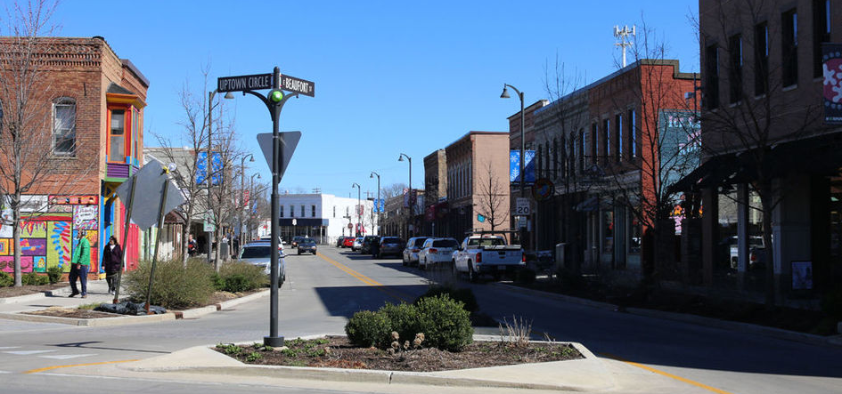
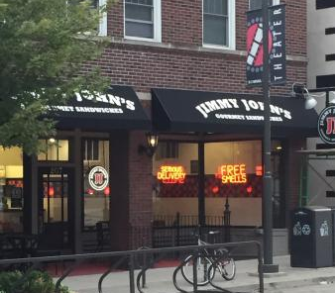
Project Scope
Goal of creating partnerships between adjacent businesses to consolidate recycling pick-up in an attempt to reduce costs and save space

Slide 3
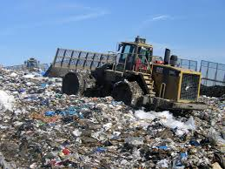
Context
McLean County reaching capacity
Not all Uptown businesses recycle
Existing waste partnerships
Space limited

Slide 4
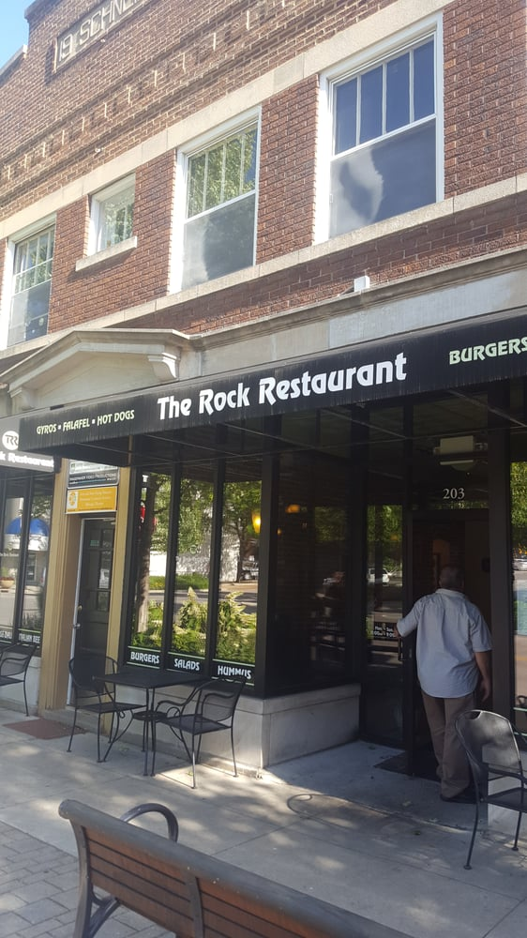
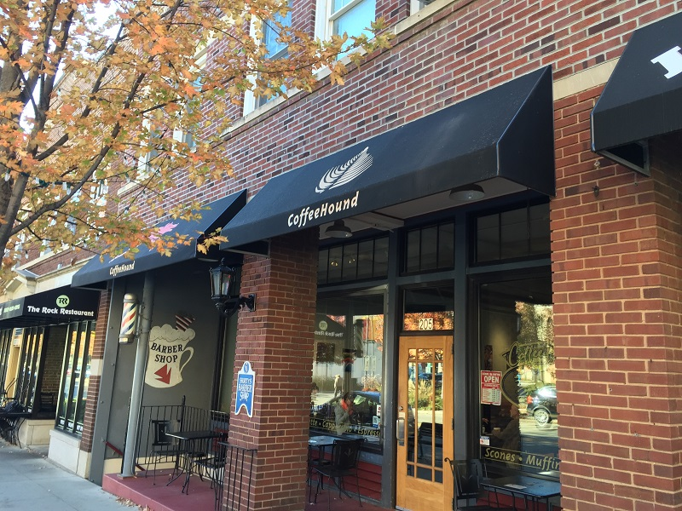
Objectives
Increase recycling and reduce costs
Focus on restaurants due to waste volume
Develop a partnership amongst The Rock, Jimmy Johns and Coffee Hound

Slide 5
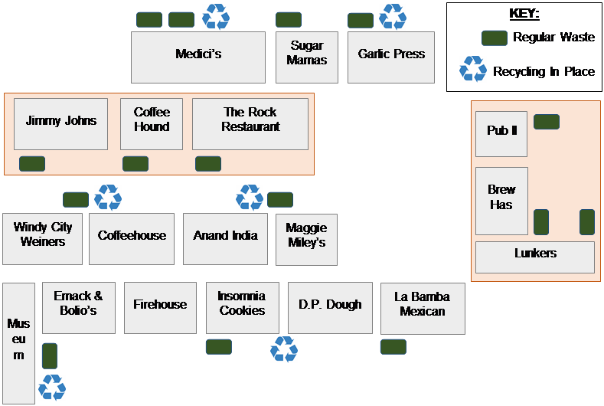

Slide 6
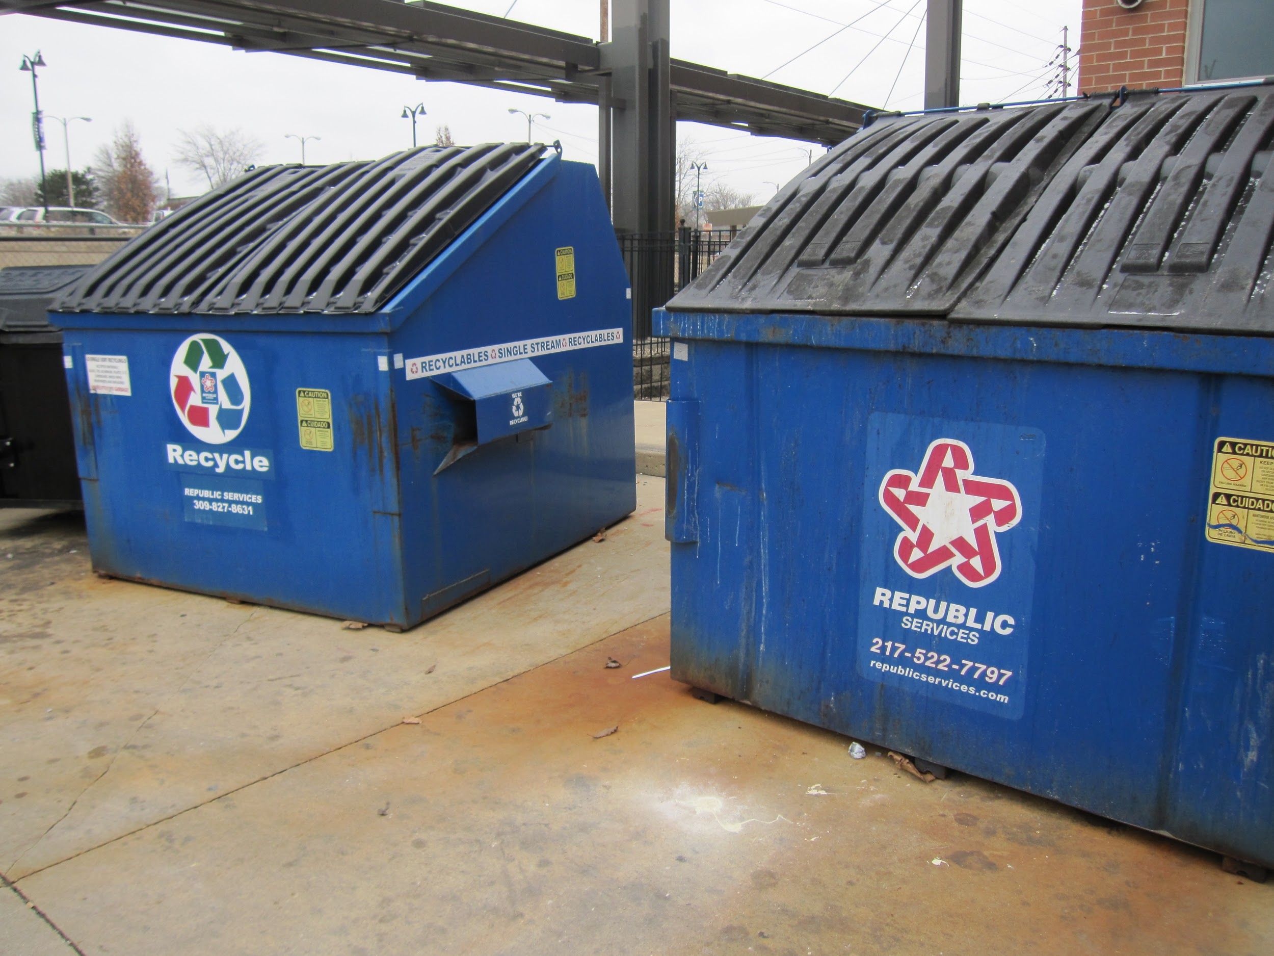
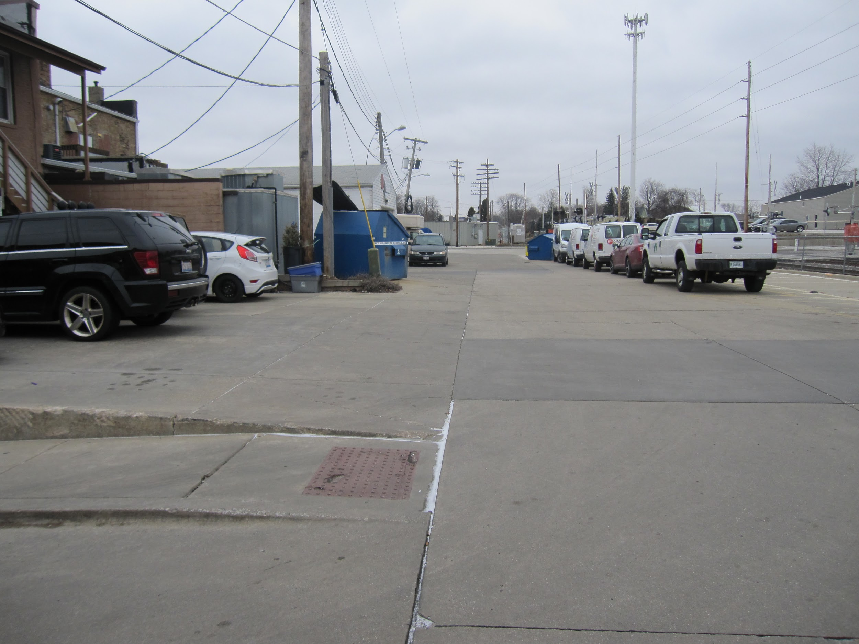
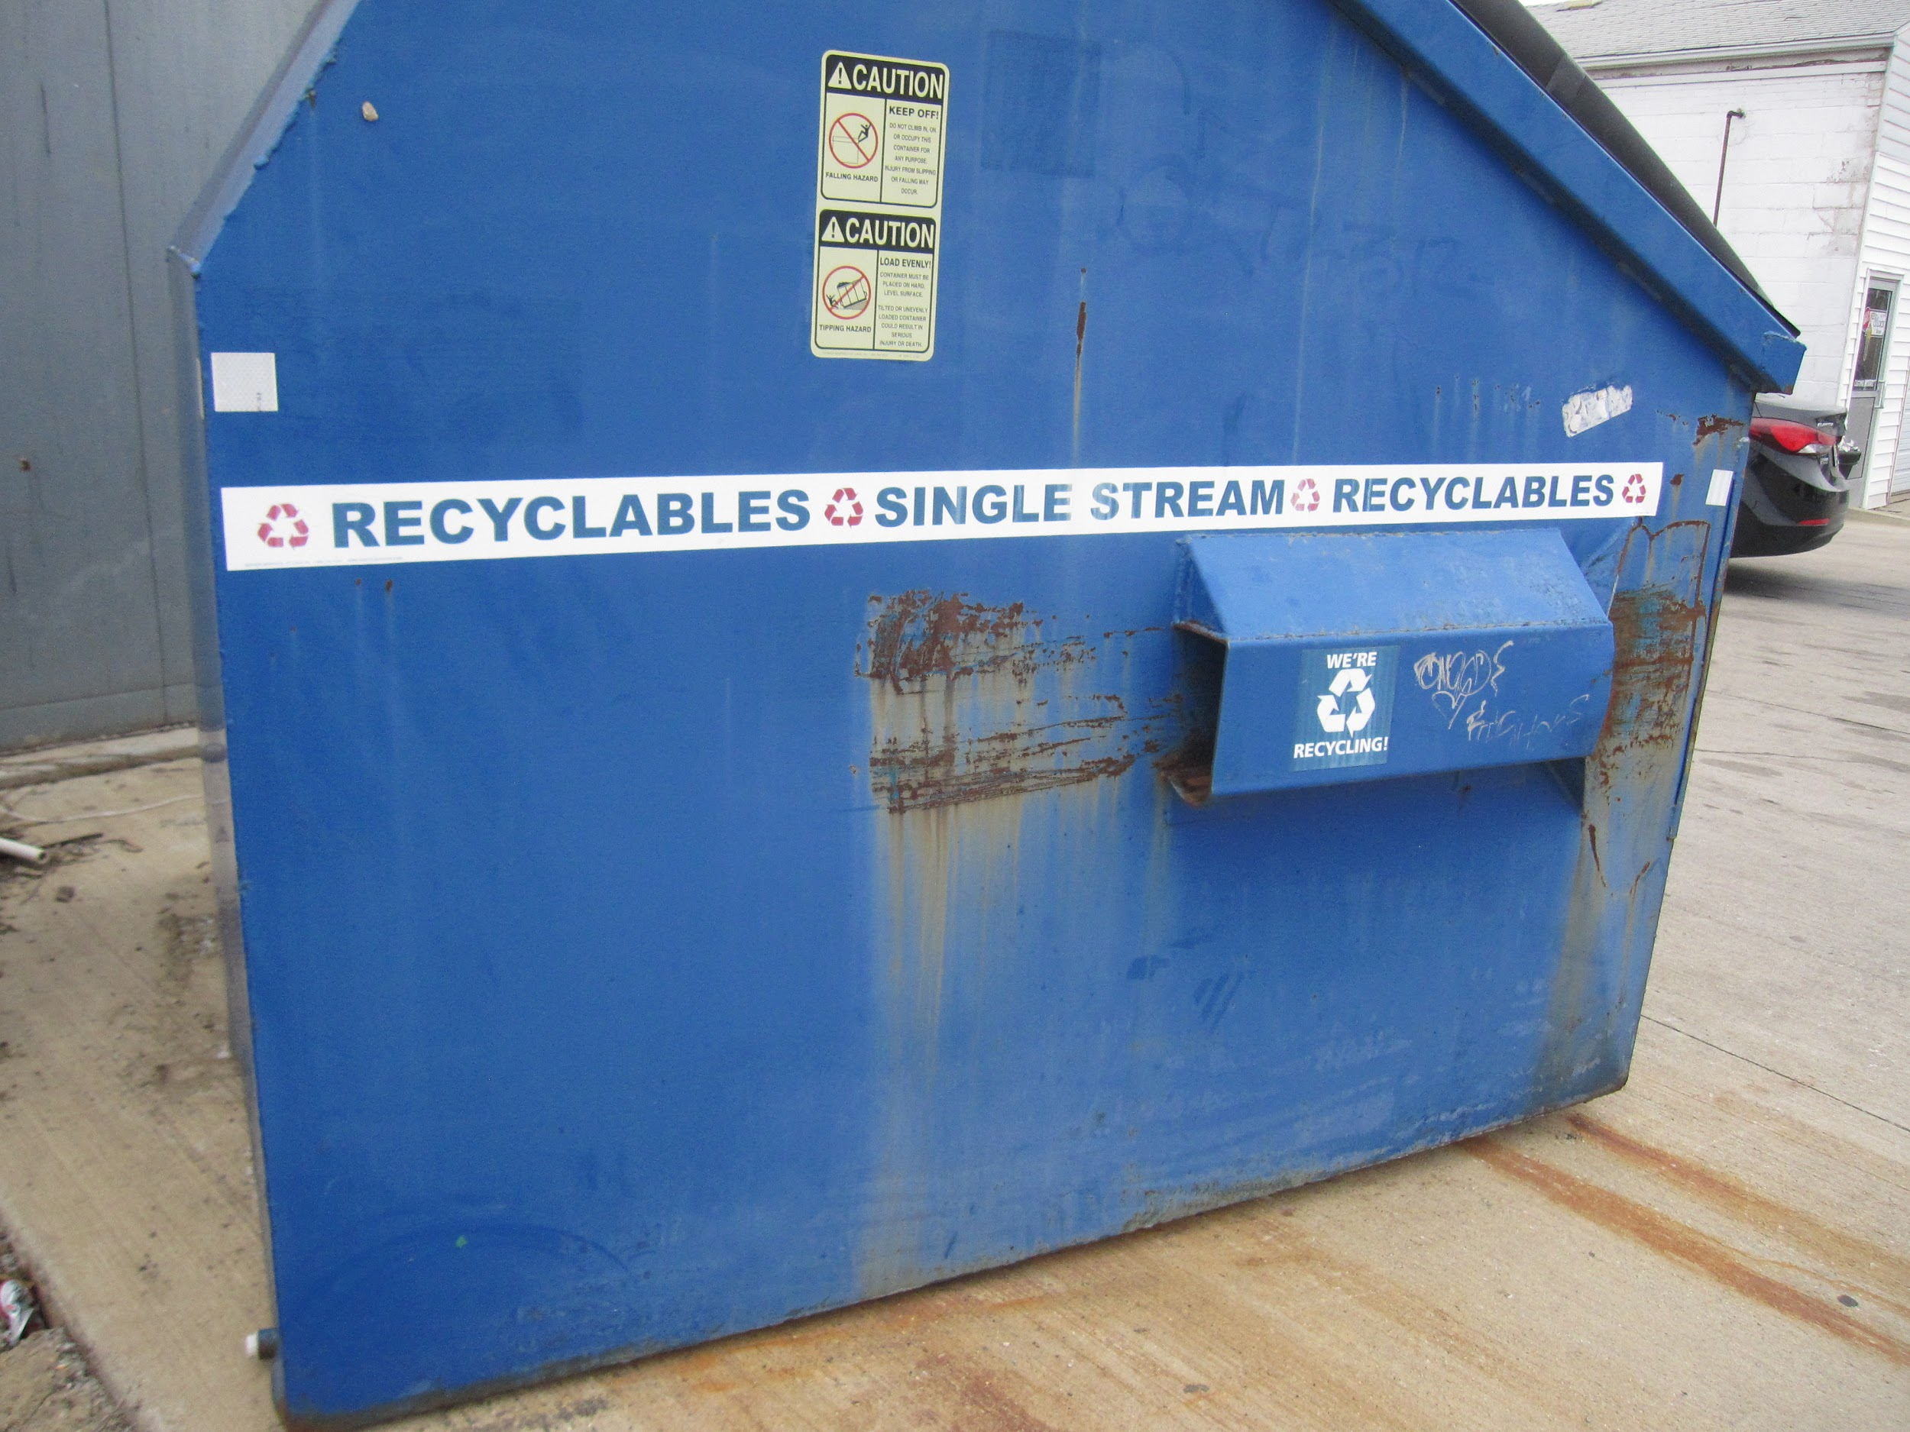
Past Success
3 blocks already have existing partnerships
Windy City-Maggie Miley’s
La Bamba-Emack Bolio’s
Medici’s - Garlic Press

Slide 7
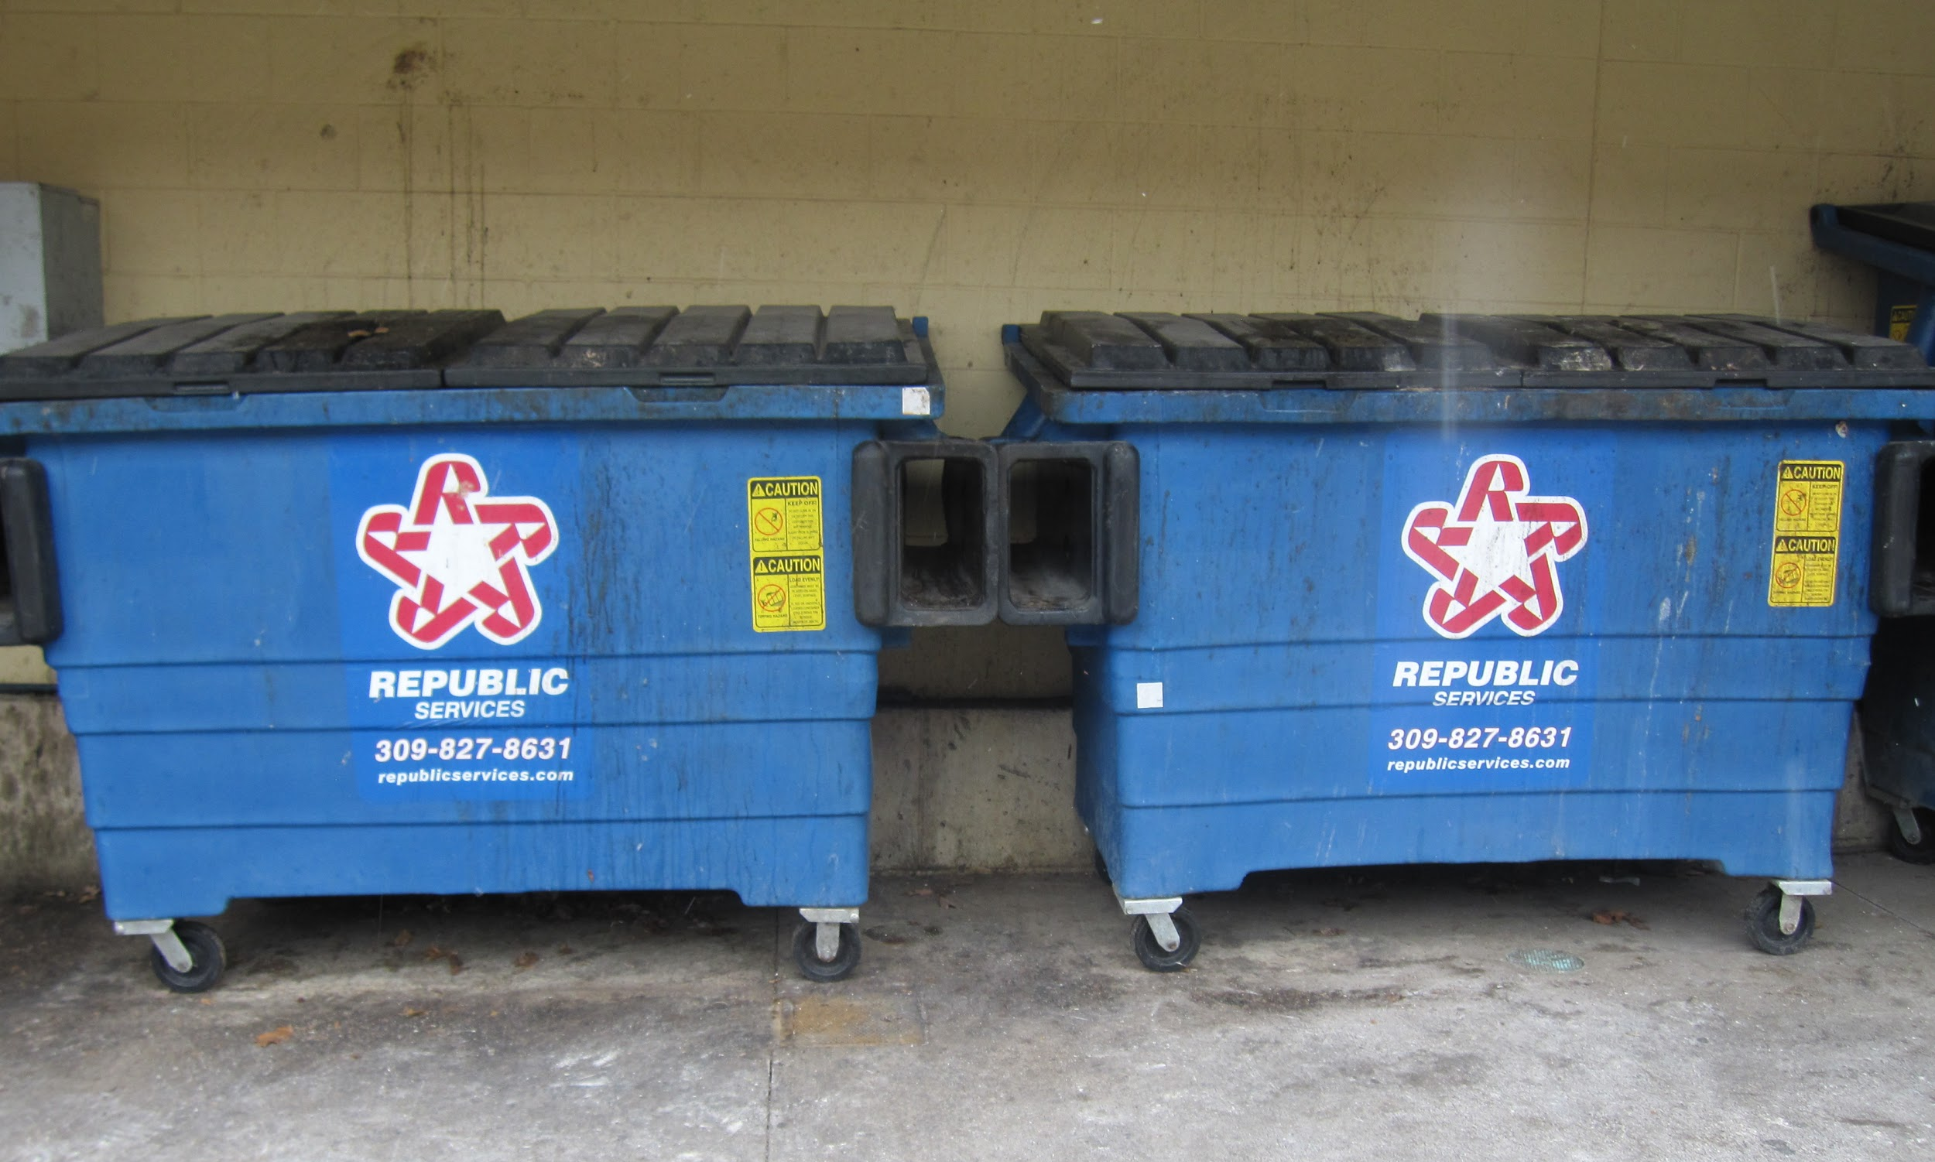
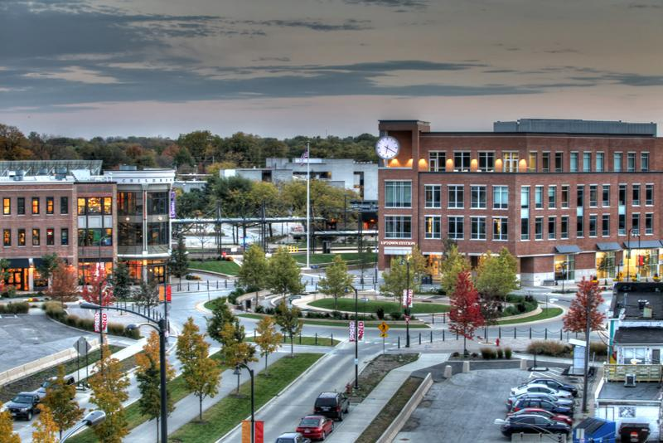
Research
Scouted recycling dumpsters
Visited Midwest Fiber & gained insight
Contacted D.P Dough - (part of successful block)
Researched recycling companies
Consulted with Joe Tulley - Uptown Manager

Slide 8
D.P Dough
Shared Single-Stream Recycling Dumpster
6-Yard Dumpster

Slide 9
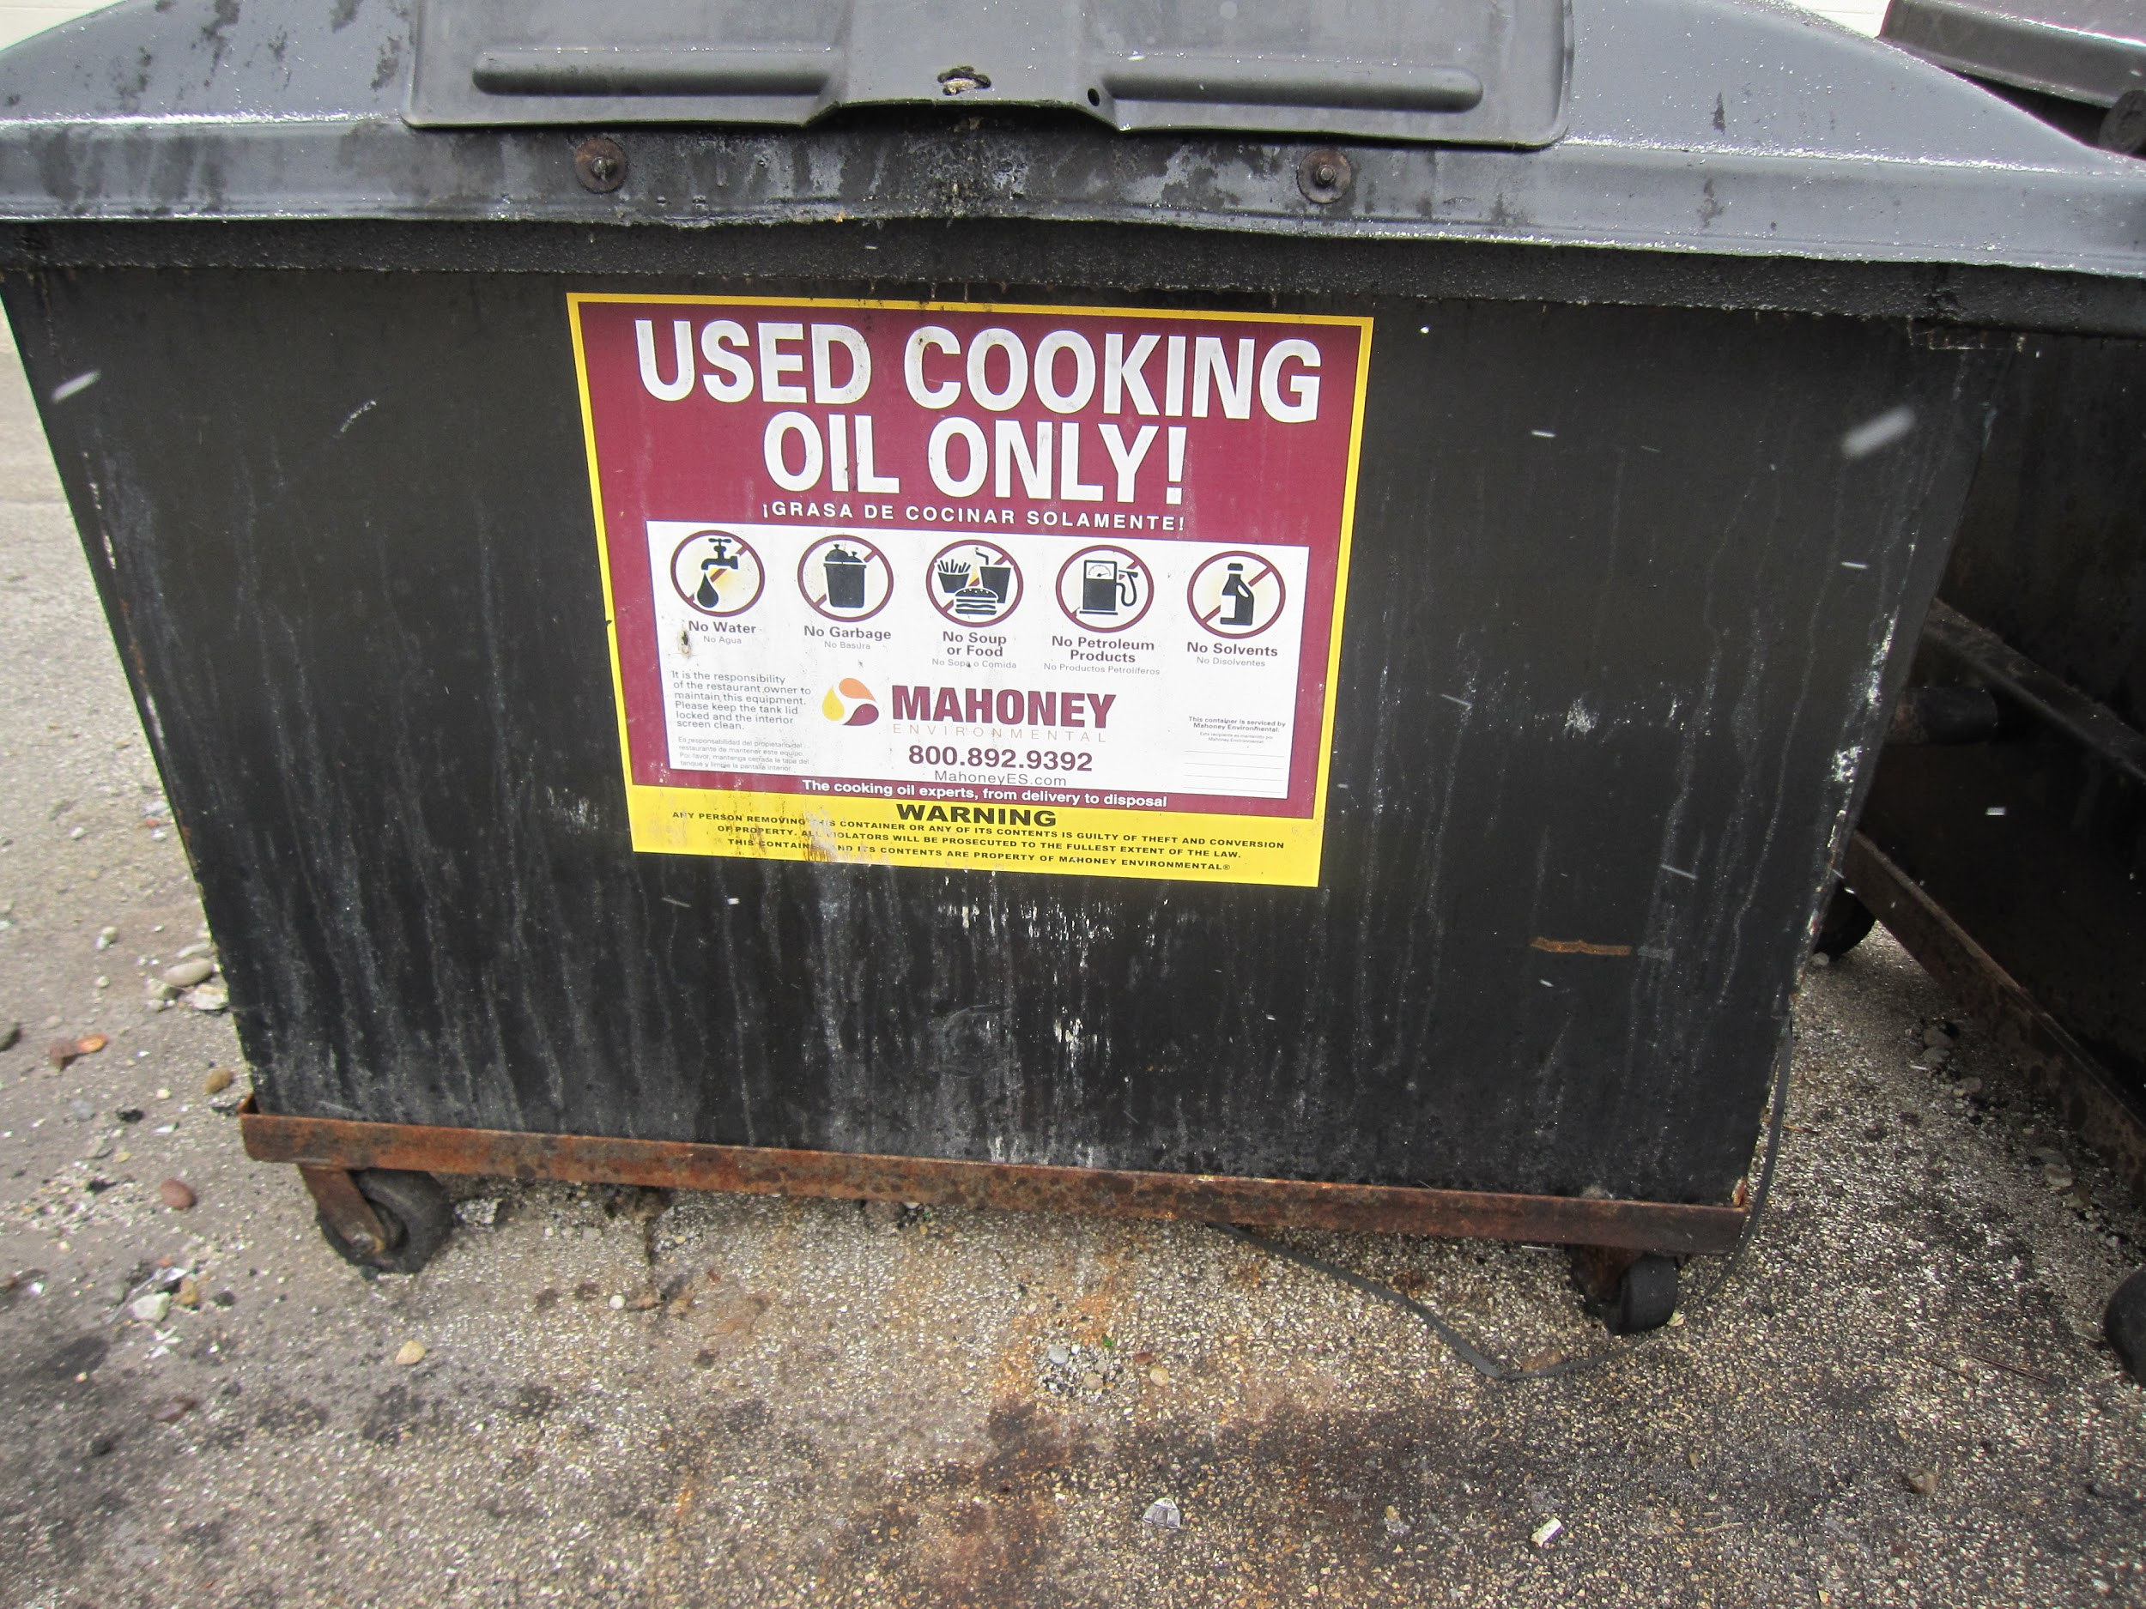
Windy City Wieners
Mahoney Recycling
Cooking Oil Recycling

Slide 10
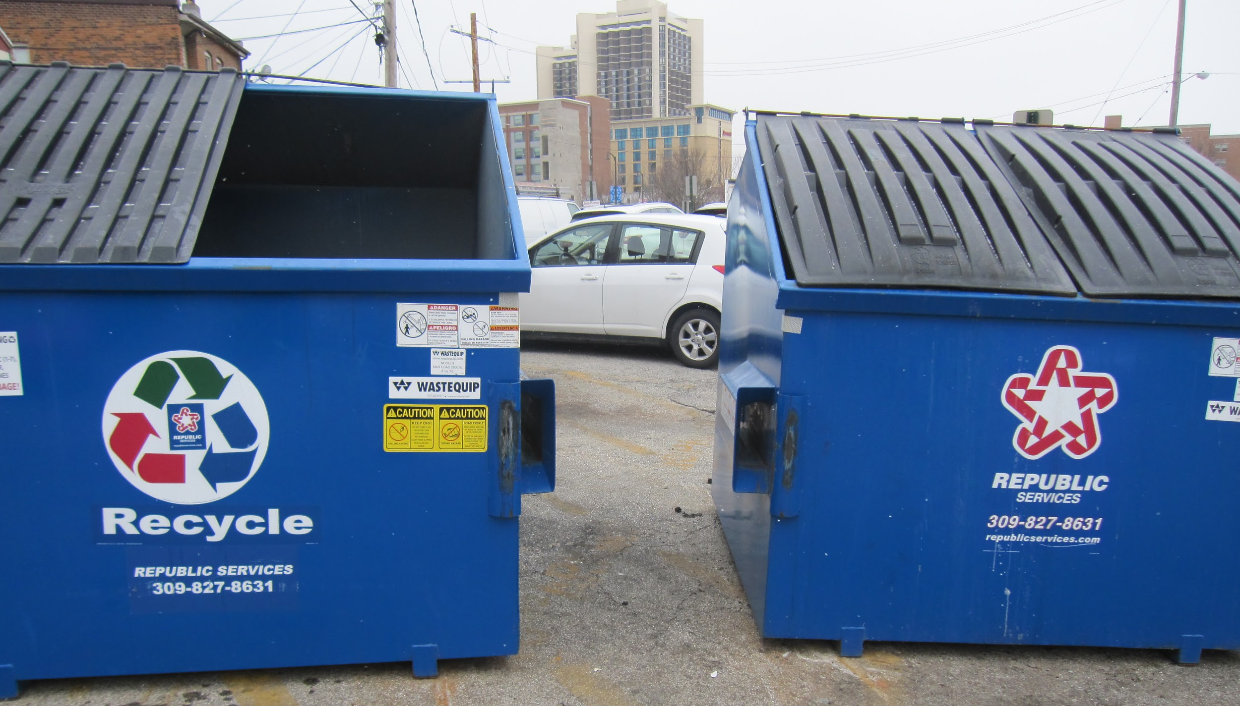
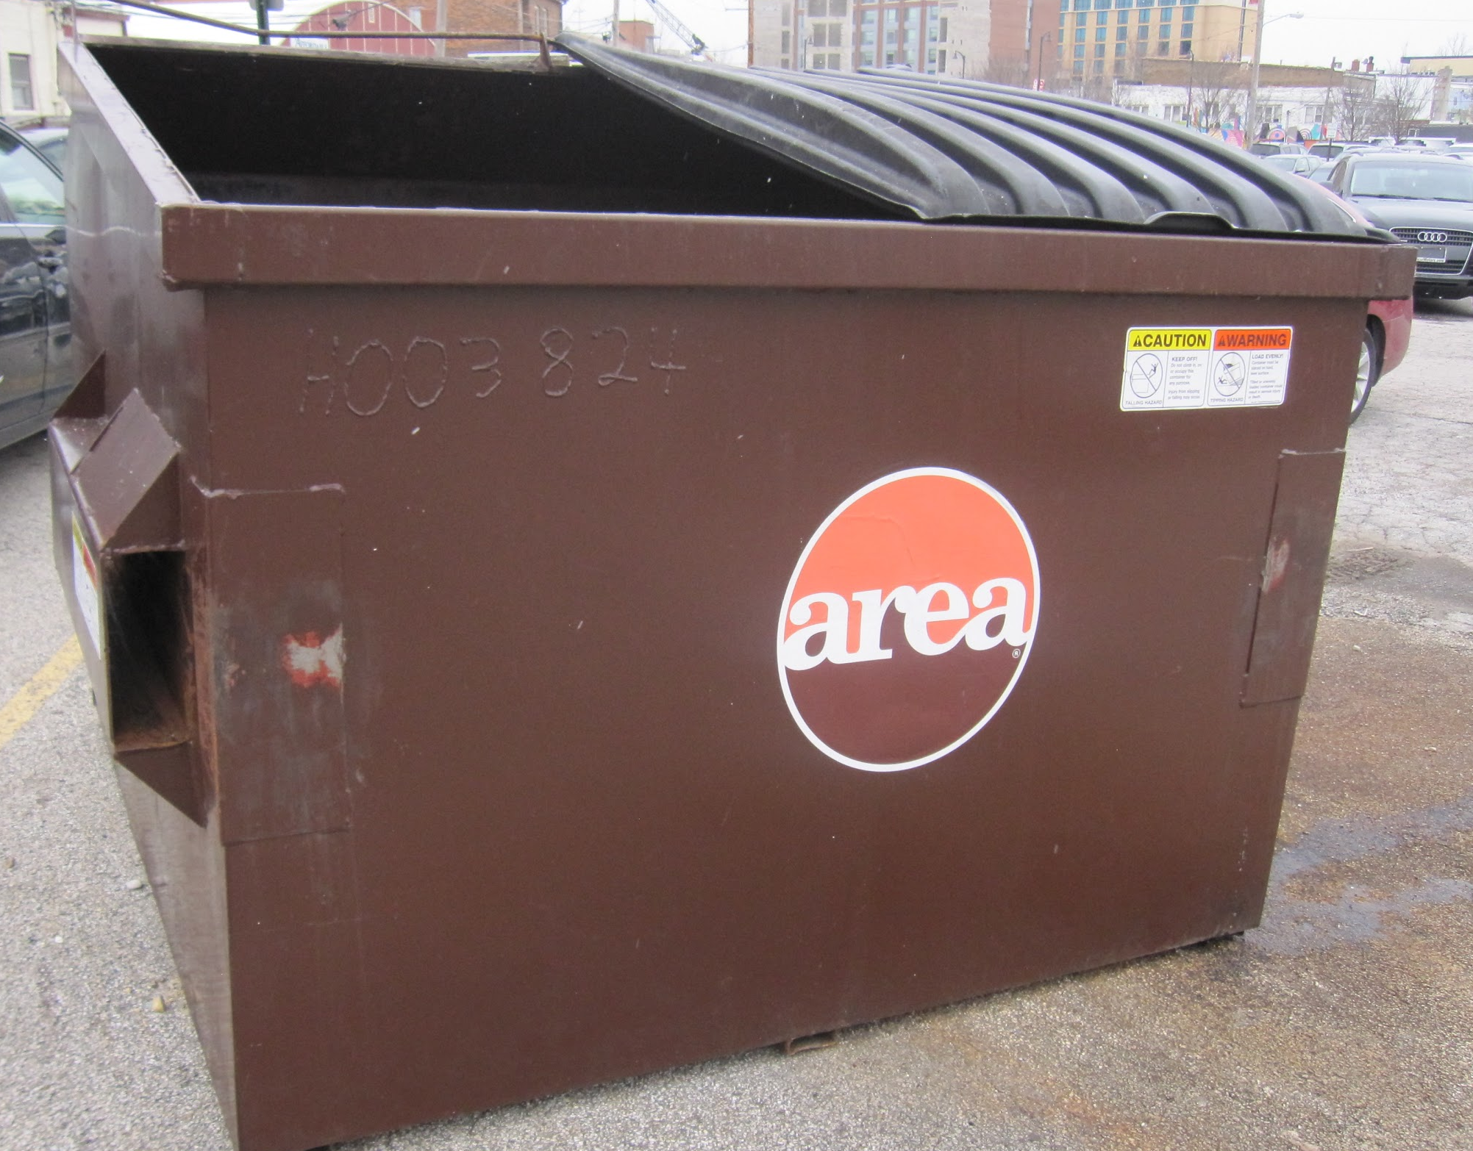
Maggie Miley’s
Republic Recycling Dumpsters

Slide 11
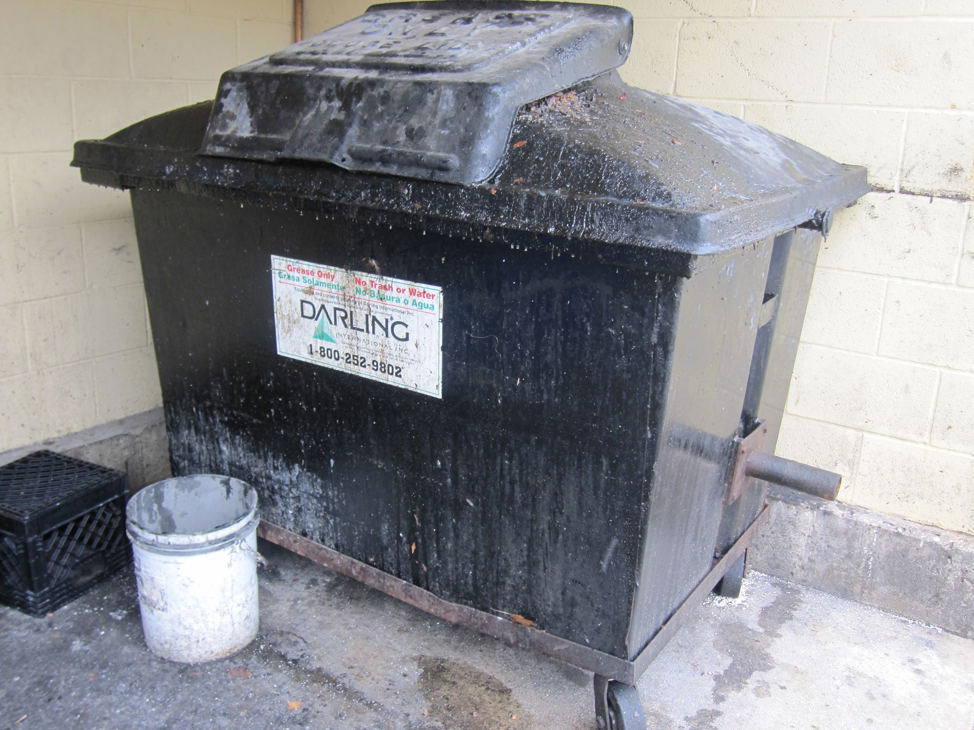
Medici
Independent
Did not form partnership on its block
Republic 2-yard roll-off dumpsters
Oil Recycling

Slide 12
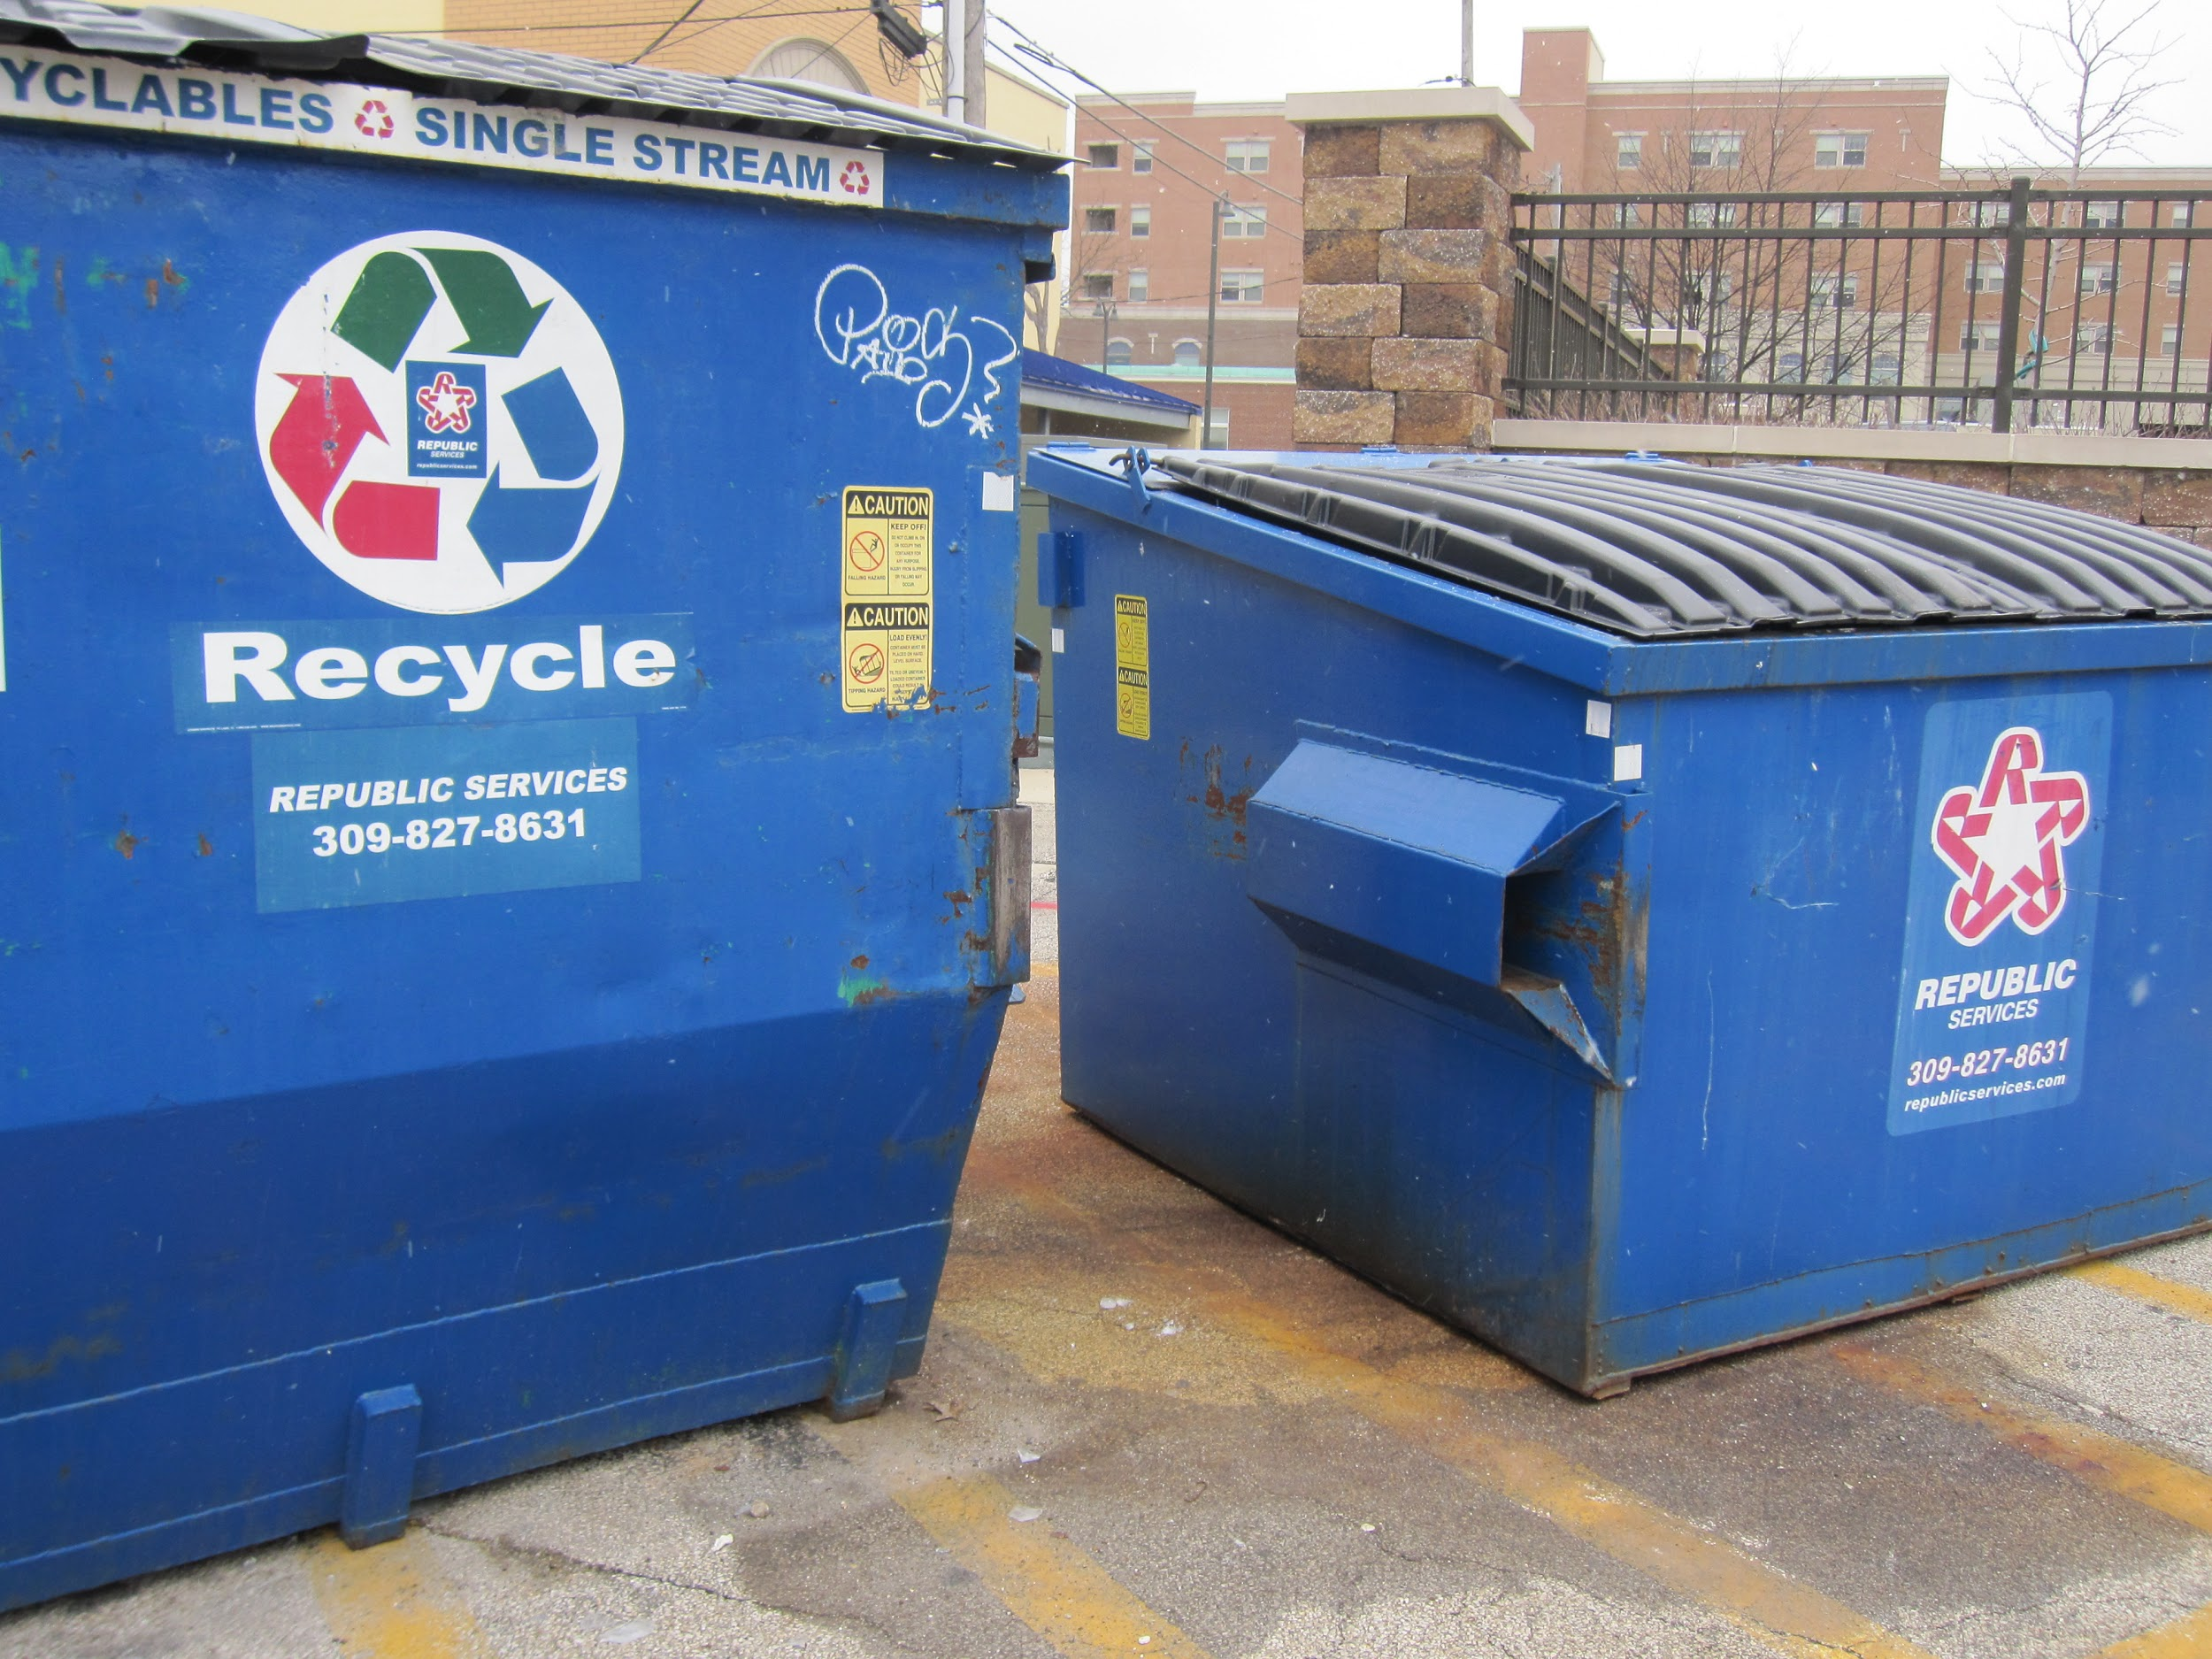
Garlic Press
Possible partnerships with other businesses
Large enough recycling dumpster to share

Slide 13
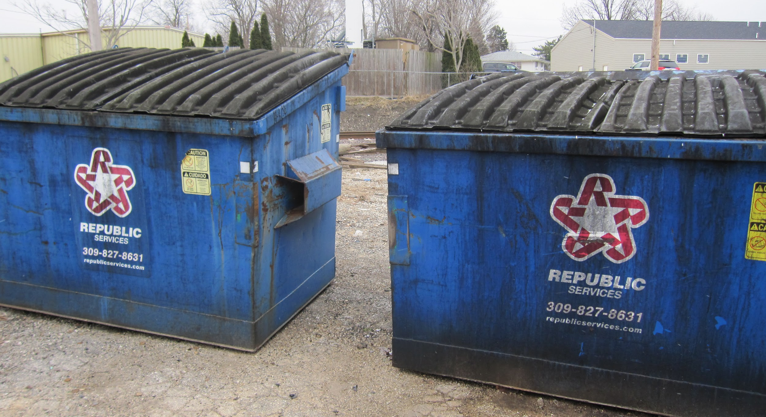
Brewhas & Lunker’s
Shared space
Lots of room to share = possibility for partnerships

Slide 14
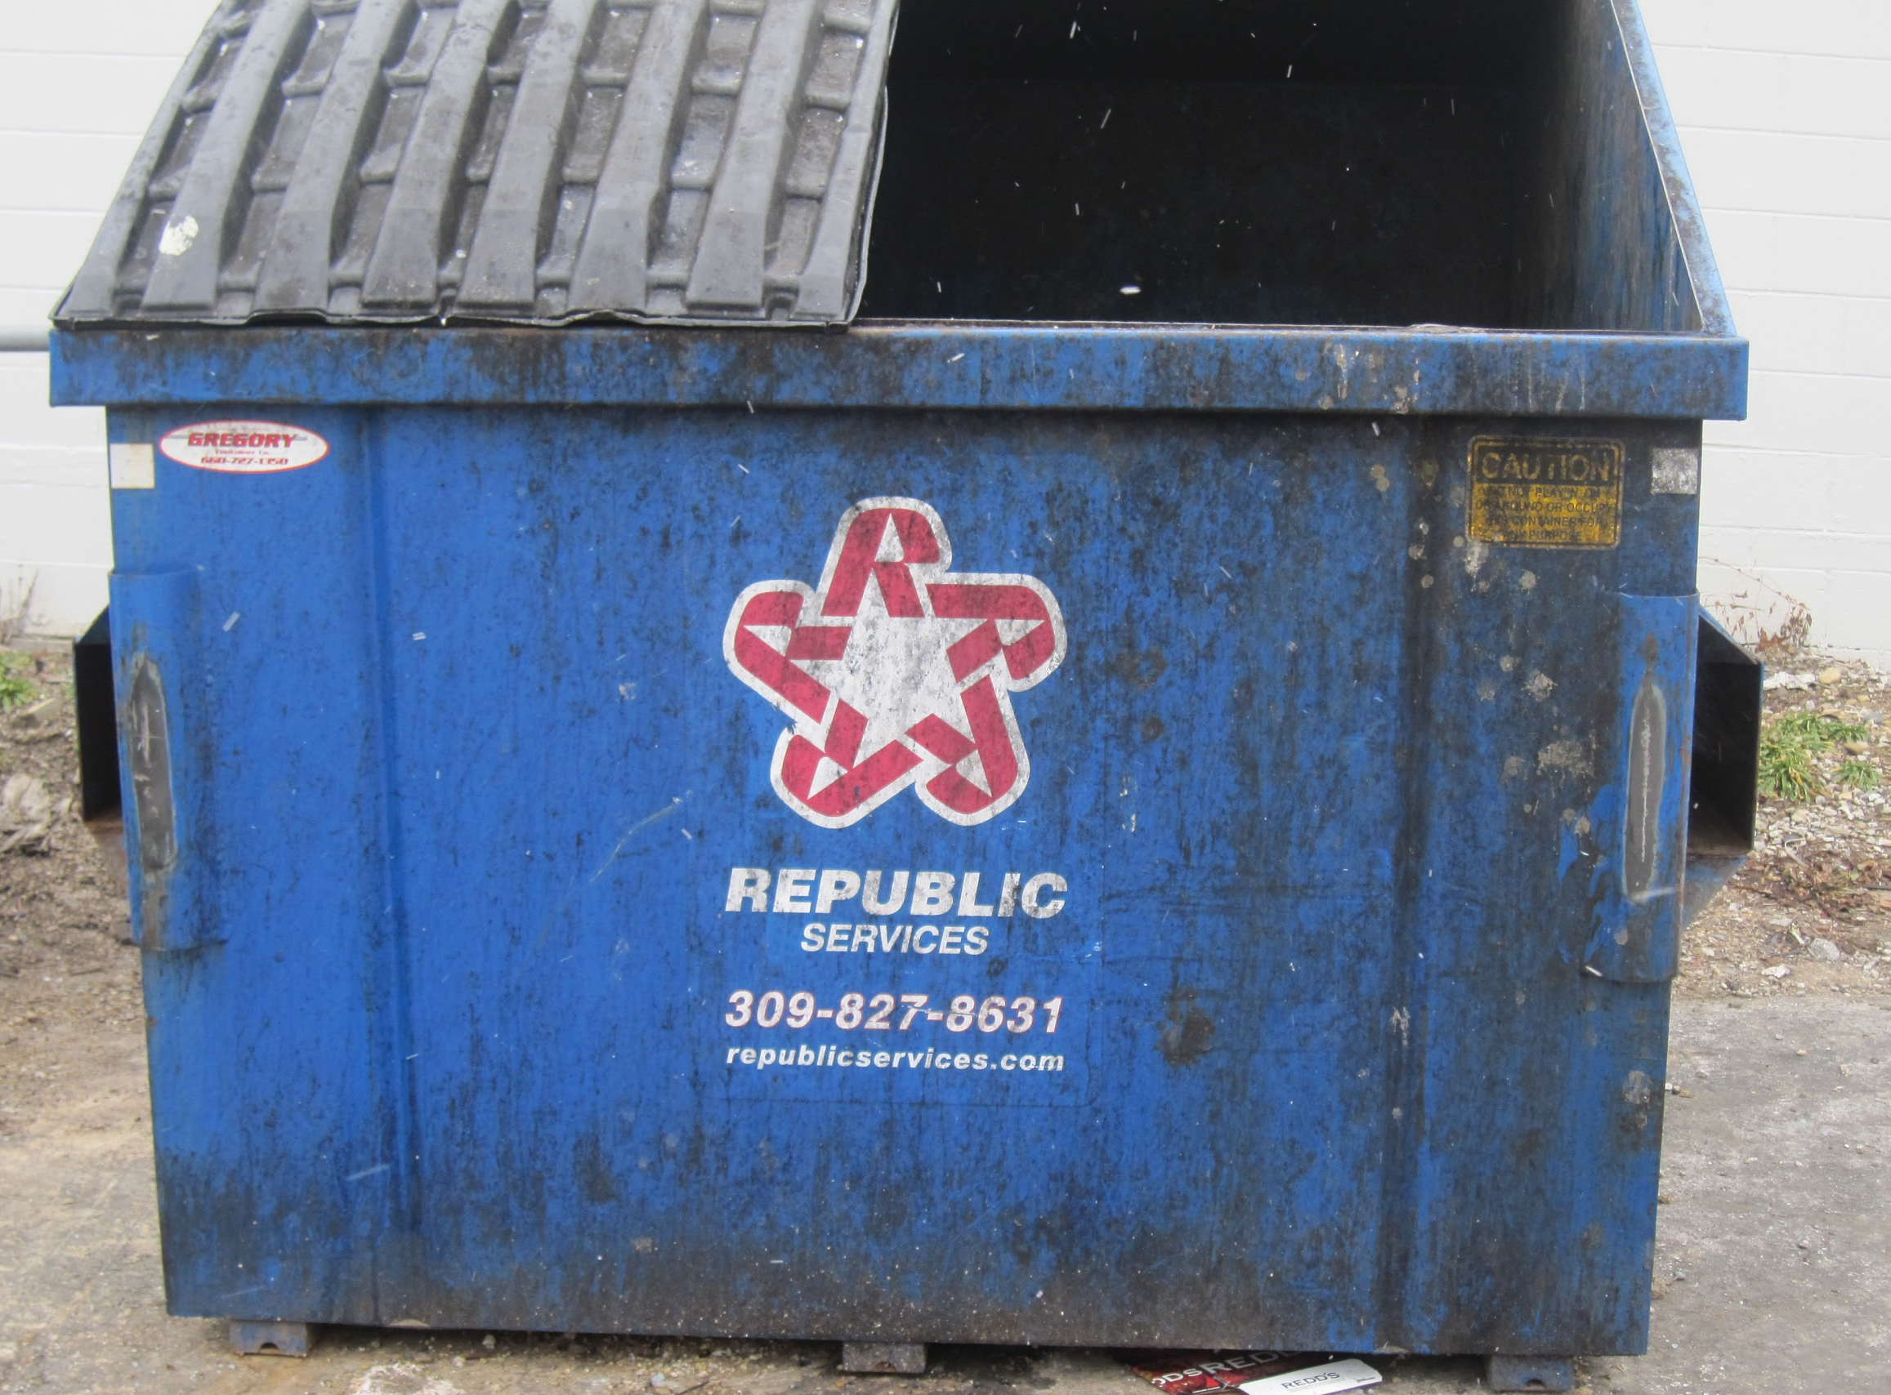
Pub II
Opportunity to form partnerships
Pub II - 707 Liquors - Ace Hardware
New management
Cost-saving opportunities

Slide 15
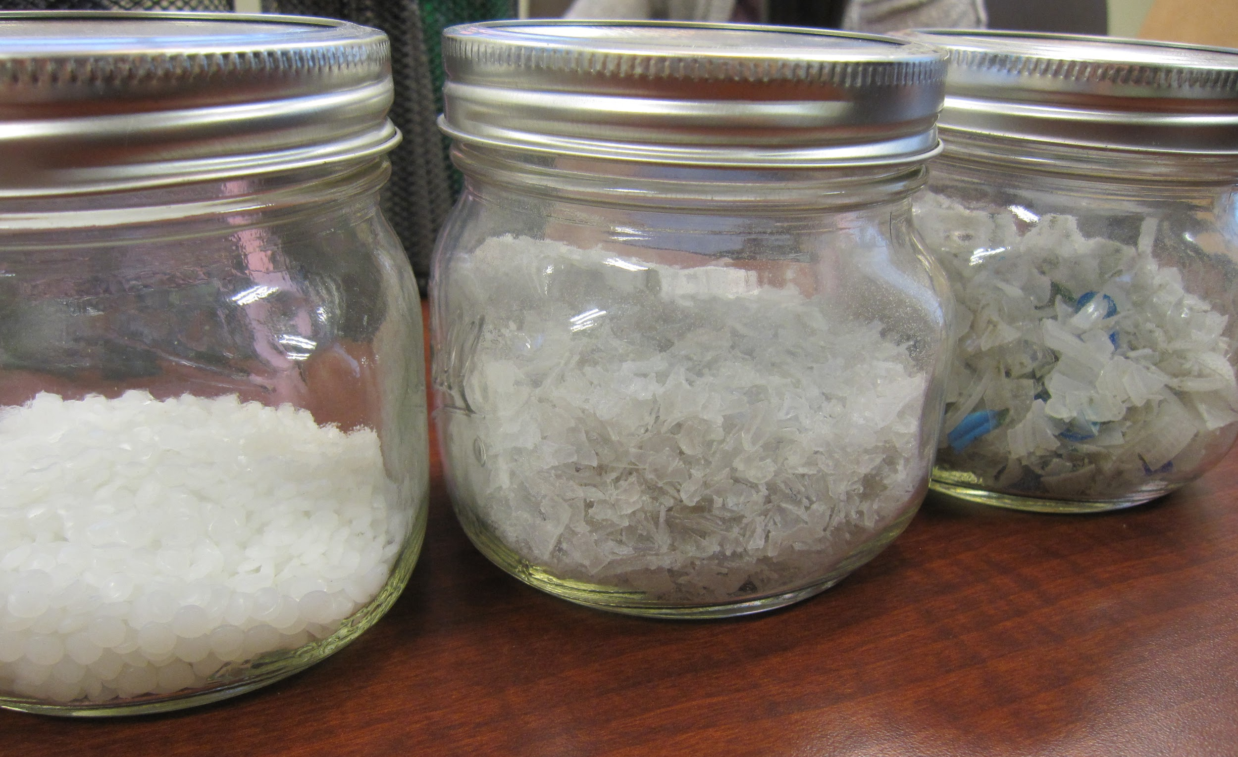
Midwest Fiber
To gain insight from recycling professionals
Explained each step in recycling process
Consulted with our project
3 Types of plastic pallets from plastic water bottles

Slide 16
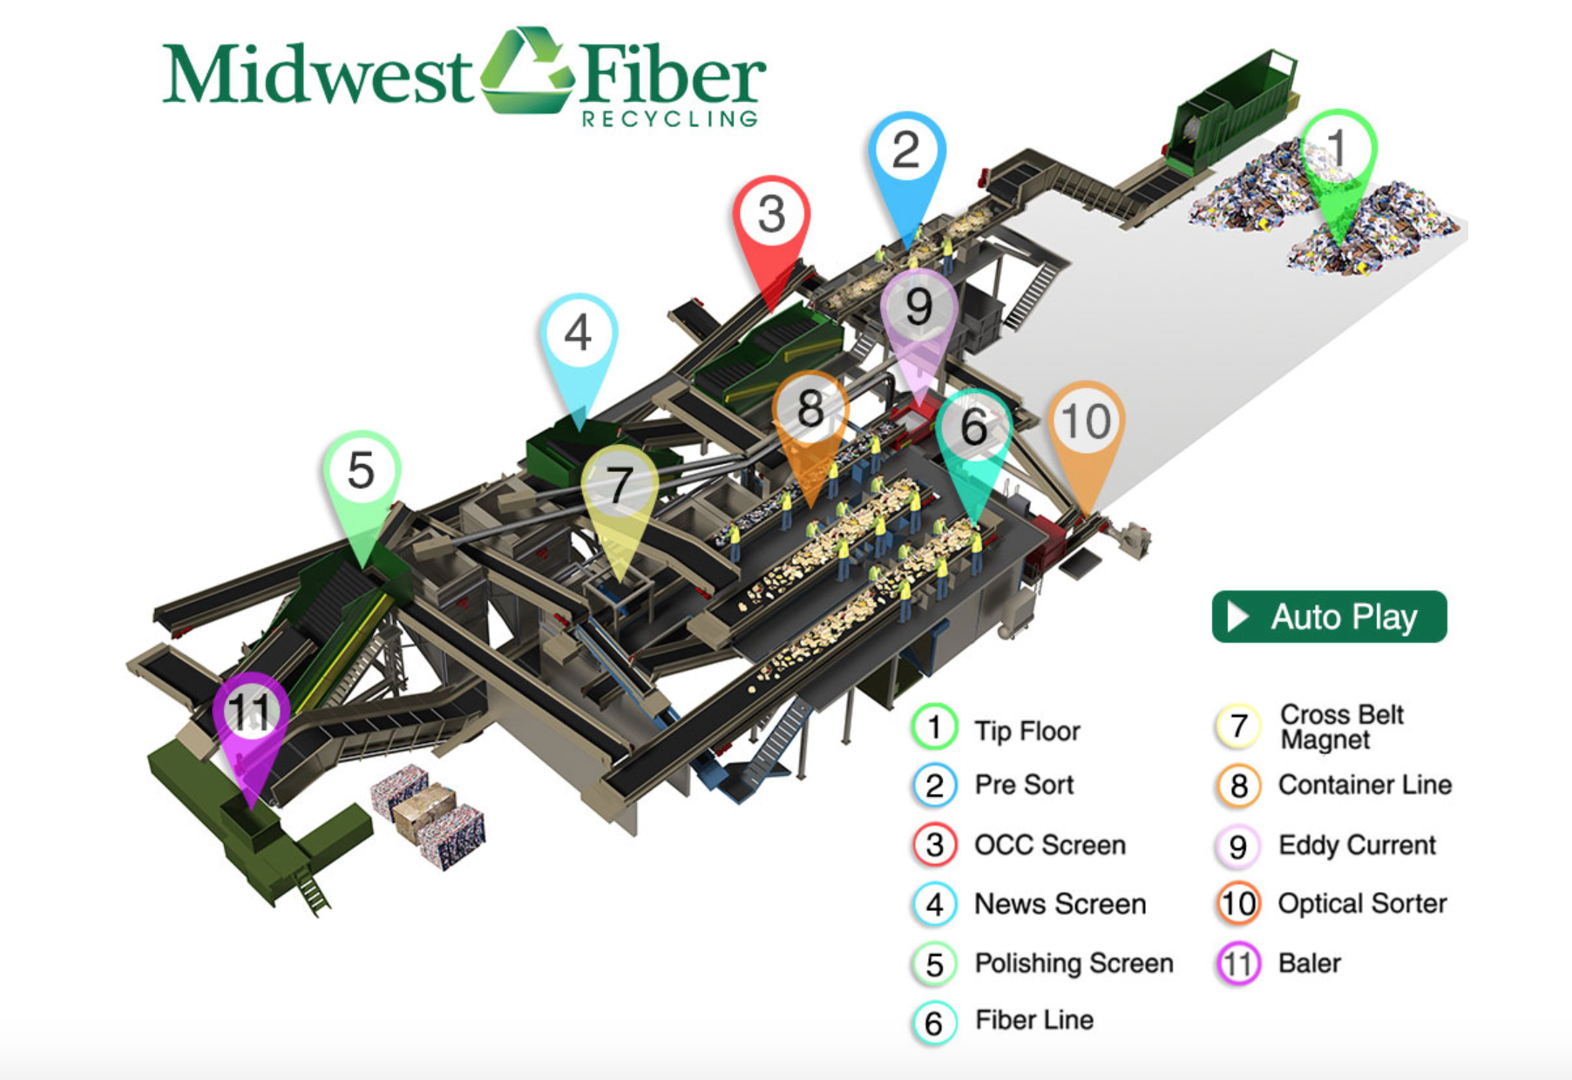
Midwest Fiber- Virtual Material Recovery Facility
Autoplay Link: http://www.midwest-fiber.com/mrf/

Slide 17
Midwest Fiber- Photos
Final Sorted Recycled Bundles:

Slide 18
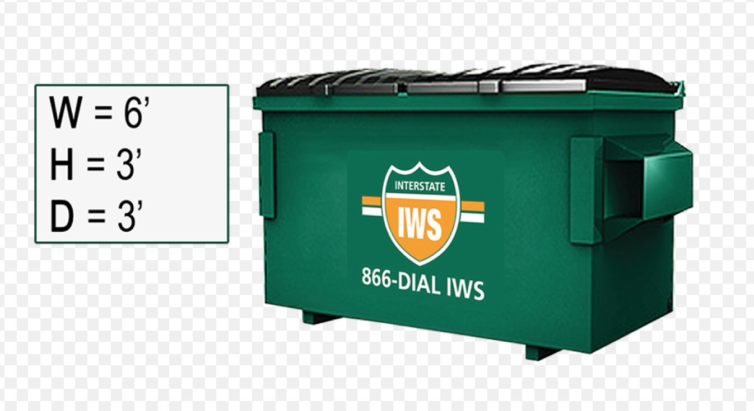
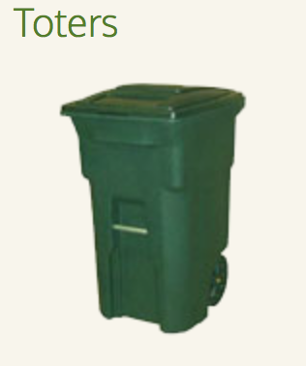
Midwest Fiber
Recommendations:
Single-stream 2 yard dumpster for frequent pick-up
Each business should have their own toter to help prevent overflow

Slide 19
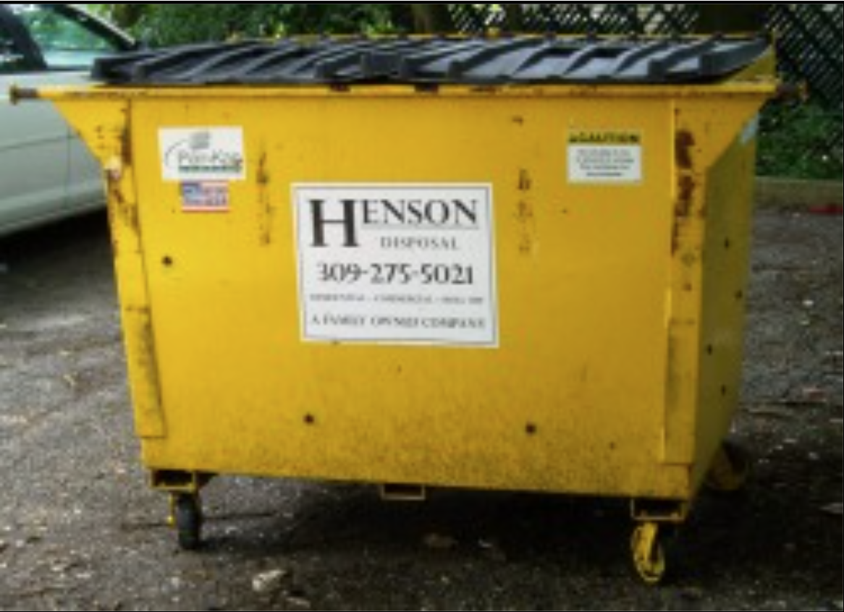
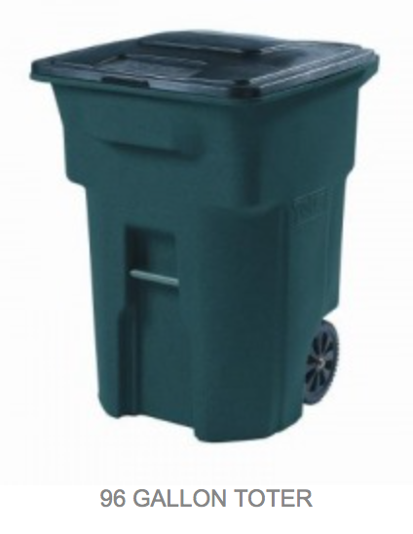
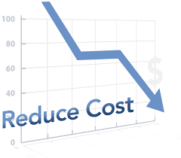
Midwest Fiber Continued…
Pricing ranging from $65-$100 (depending on size, number of containers, and amount of recyclables)
Incentive: reduced costs
Competitors: Henson
Hensen Toter
Notes:
Competitor: “If our initial quote isn’t less expensive than what you’re currently paying, we’ll beat and competitors price and throw in a month of service free!” Hensen could be a possible option for a cheaper option to have their recyclables picked up.
Incentives: partnerships with multiple businesses can reduce to cost of recycling bill each month. Diverting waste from regular dumpster can reduce costs with less frequent garbage pick-ups and reducing the amount of waste produced for pick-up.

Slide 20
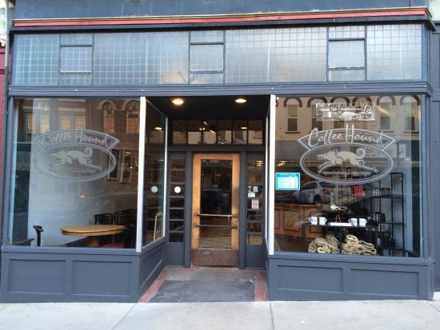
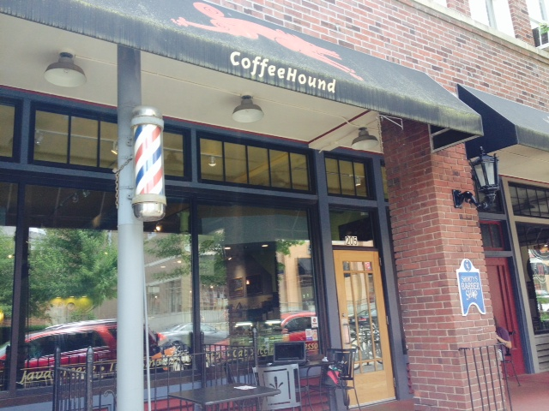
Coffee Hound
Recycling route at Bloomington, IL location
Pick up recycling from Normal, IL location
Recycle, Reduce, Reuse
Notes:
Coffee Hound: Has their own garbage and recycling system. Coffee Hound’s downtown Bloomington’s location bakes all their goods in the Bloomington, and they have their own recycling pick-up there as well. That being said, when Coffee Hound drops off their baked goods in the Normal location, they take their recycling to their Bloomington Coffee Hound to get picked up every week. They are very good about reducing, reusing, and recycling themselves.

Slide 21
Challenges
Time constraints
Scheduling conflicts
Business owner priorities vary
Each business operates as an individual unit
Difficulty in getting key businesses to get involved
Asking businesses to participate involuntarily
Forming partnership with businesses, again involuntarily
Notes:
Diffusion of innovations theory

Slide 22
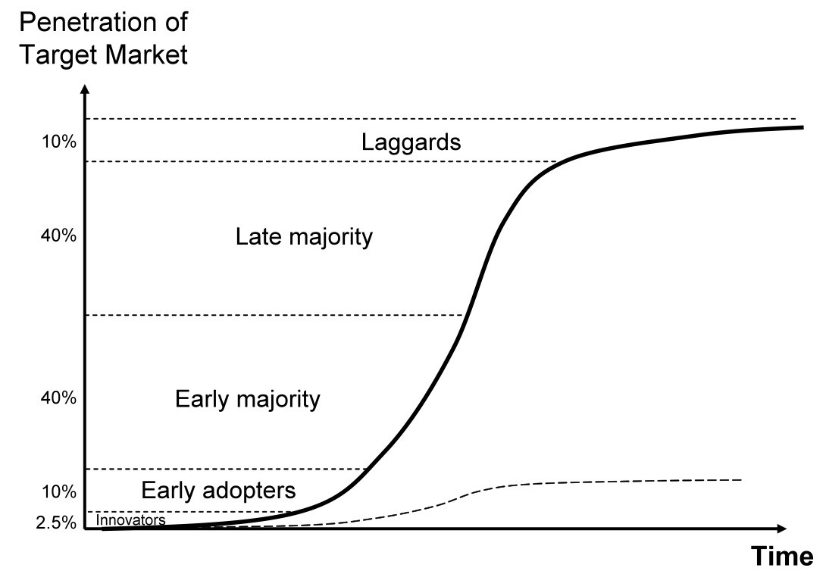
Diffusion of Innovations Theory
Potential Adopter’s view of a change agent
Advantageous innovations do not sell themselves

Slide 23
Recommendations for Moving Forward:
Make sure businesses are willing to participate
More research on successful blocks
Know how much waste each business generates
Research recycling options & quote
Involve mentors to consult businesses
The Rock & Jimmy John’s partnership
Look into Pub II - 707 Liquors - Ace Hardware as a potential partnership

Slide 24
Questions?
Thank You

