Slide 1
No Media Outlets or Reporting Allowed in this Session This PPT has been editted
Thank you

Slide 2
X MLB Team
Major League Baseball and Millennials

Slide 3
Jake Baumgarten
Alexis Beauford
Ryan Bogar
Morgan Kerlin
Kayli Miller
Scott Stewart

Slide 4
Innovation Consulting Community
Major League Baseball and Millennials
Providing consultation to Team X
Generate promotions to reach millennial consumers
Construct 3-6 ideas to present to X Marketing and Client Services teams
In-person presentation at X Stadium in April

Slide 5
Our Client - X
- X campaign
- #X in MLB TV ratings
- #X in attendance across all leagues
- Klout score: XX

Slide 6
Target Demographics
The X have fans in X
Increase millennial involvement through social media and in-game activities
Current Overall Fan base: X
Millennial Fan Base: XXX
There are approximately X million users on Twitter monthly
Users are primarily ages X-X

Slide 7
Current Sponsors
X
Marriott Hotels
X
Alcohol
MillerCoors, X, X
Auto Parts
X and X

Slide 8
Purpose of Promotions
Millennials are most easily engaged on social media
Millennials tend to enjoy going to events and outings in larger groups
Millennials are more likely to purchase items if they are offered at a discount or packaged with other items
Millennials are attracted to large, social atmospheres

Slide 9
Wet n’ X
Objective of Promotion:
Attract fans to generally low-attended games in the hot summer sun
Primary Target Market:
Millennials (ages 21-30) living in the X city area
Secondary Target Market:
College students home for the summer
Length of Promotion:
One-game event
Benefit to Team:
Increases ticket sales on typically low-attended games

Slide 10
Wet n’ X
Miller Lite Pool Party
Set up pools in a X Stadium parking lot
Rent out pools like suites
Miller-Lite (or other sponsor) sponsored barbecue after pool party/before game
Potential Sponsors
Alcohol Vendor, Towels, Food, Pool supplies, Chairs, sunscreen
Phone video could follow to post on social media platforms (Twitter, Facebook, Instagram, Snapchat)
Marketing Medias
Social Media, In-Game PAs, Grassroots (Power & Light District), Radio

Slide 11
Tee Shirt Design Competition
Objective of Promotion:
To engage the fans across social media platforms
Primary Target:
Millennials active on social media
Secondary Target:
Local artists or individuals with knowledge of graphic design
Length of Promotion:
Weekly voting on social media over the course of a month
Benefit to X:
Increase interaction with fans on social media

Slide 12
Tee Shirt Design Competition
Social Media Exclusive Promotion
Can leverage multiple platforms (Facebook, Twitter, Instagram)
X fans will design a “Raised X” t-shirt and submit the designs
The top 10 designs will be voted on
The winning 3 will be featured featured during the next season on T-shirt Tuesdays (once a month throughout the season)

Slide 13
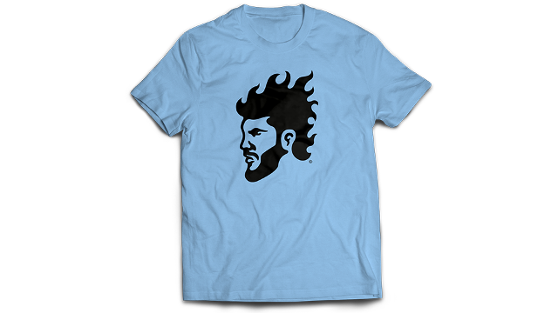
Tee Shirt Design Competition

Slide 14
Suite For A Seat
Objective of Promotion:
Offer a suite ticket for the price of a field box ticket (price varies depending on which game)
Primary Target:
Consumers active on social media get a first chance at “exclusive tickets”
Secondary Target:
Those looking to go to the game but not sit out in the blazing heat
Length of Promotion:
Meant to be a flash sale because the uncertainty of schedule and ticket sales
Benefit to Team
Fill empty suites

Slide 15
Suite For A Seat
Potential Sponsors:
Price Chopper
There can be a coupon on the back and the promotion could be “The suite’s price has been chopped”
Social media followers can have first notice to discounted suite prices
Food offerings could include lower-tier items: hot dogs, popcorn, soda

Slide 16
Snapchat Scavenger
Objective of Promotion:
Engage fans on Snapchat throughout X
Primary Target
Millennial fans
Secondary Target
Snapchat users
Length of Promotion
One afternoon (possibly multiple, if successful)
Benefit to Team
Increase engagement and awareness of X Snapchat

Slide 17
Snapchat Scavenger:
X staff places 8-10 mini X crowns in famous spots around X and gives clues via Snapchat as to where they are
Power & Light District, Union Station, Crown Center, etc.
First fan to find the X (and staff) wins two ticket vouchers for select matchups
Can post pictures of winners on other social media sites (Facebook, Instagram, etc.)
Potential Sponsors:
Open to any sponsor
Can create a filter on the ‘clue’ that incorporates sponsor

Slide 18
Spring Break with the X
Objective of Promotion:
Connect collegiate millennials to the team
Primary Target:
Millennials
Secondary Target:
Families
Length of Promotion:
Sold or promoted as a one week package
Will run for the duration of spring training
Benefit to Team:
Generate additional revenue from Spring Training Activities

Slide 19
Spring Break with the X
Ticket packages available for spring break weeks throughout March for millennials to enjoy spring training with a group of friends
Encourages fans to follow the team from pre-season to post-season
Potential Sponsors:
Hotels, Airlines, Car Rental, Restaurants
Major college spring breaks run from 3/11 - 4/3 (3 seperate week packages)

Slide 20
Car Care Package
Objective of Promotion:
Connect consumers with auto-aftermarket sponsors
Primary Target:
College Students
Secondary Target:
Car owners/parents of car owners
Length of Promotion:
One game promotion, multiple games throughout the season (College Nights)
Benefit to Team:
Incorporate auto sponsors to attract college student, collect contact info for sales team

Slide 21
Car Care Package
Giveaway package to students who take their cars to college
Includes tire pressure gauge, jumper cables, and other automobile necessities
Run during college nights at X Stadium
X-State,
Advertised in PA announcements and on scoreboards
Telling fans to register by end of 5th inning
Fans sign up at table on concourse
Receive text during 7th inning if they win
Sponsoring auto company coupons on back of tickets
Encourages fans to visit sponsor location

Slide 22
Travel Like X Sweepstakes
Objective of Promotion:
Give fans a once-in-a-lifetime experience to foster a lifelong love of the X
Primary Target
Young adults
Secondary Target
Fans of any age
Length of Promotion
Month long entry window, promotion lasts one short away stand
Benefit to X
Provides contact information for sales team and promotes fan loyalty

Slide 23
Travel Like X Sweepstakes
Win opportunity to spend a road trip with the team
Weekend long road trip
Fly with X players, stay in hotel, attend batting practice and games
Team and players become more accessible to fans
Potential Sponsors
Hotel, airlines, banks, etc.
Promoted through multiple platforms
X website, social media, and in-game PA reads

Slide 24
Questions?

